Slide 1

SuperMarket
(EDA)

Slide 2
Introduction
This report provides an exploratory data analysis of the dataset, focusing on sales performance across different dimensions such as categories, sub-categories, regions, customers, and time. The analysis uses various statistical and visualization techniques to uncover key patterns and trends. These insights help identify high-performing products, customer segments, and regions, as well as provide an understanding of sales distribution and correlations. Such findings are valuable for supporting decision-making, improving business strategies, and identifying opportunities for growth.

Slide 3
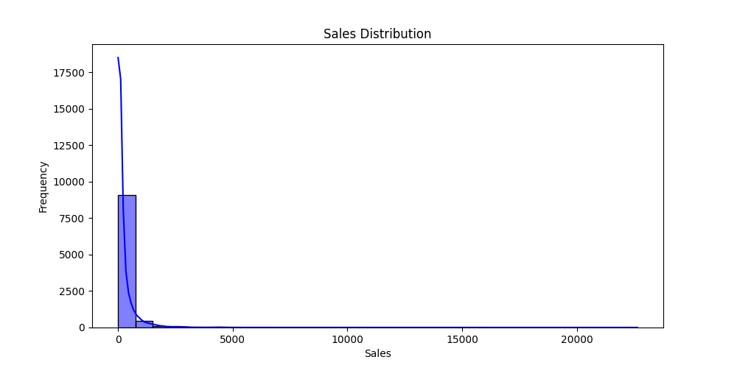
The histogram shows how sales values are distributed across all transactions.
Most transactions tend to be clustered at lower sales values, while only a few transactions reach very high sales amounts.
This indicates that the majority of orders are small to medium sales, but there are some large sales outliers that drive up revenue.
Such a distribution is common in retail, where everyday products sell in bulk at lower prices, and only a few premium or bulk orders have very high sales.

Slide 4
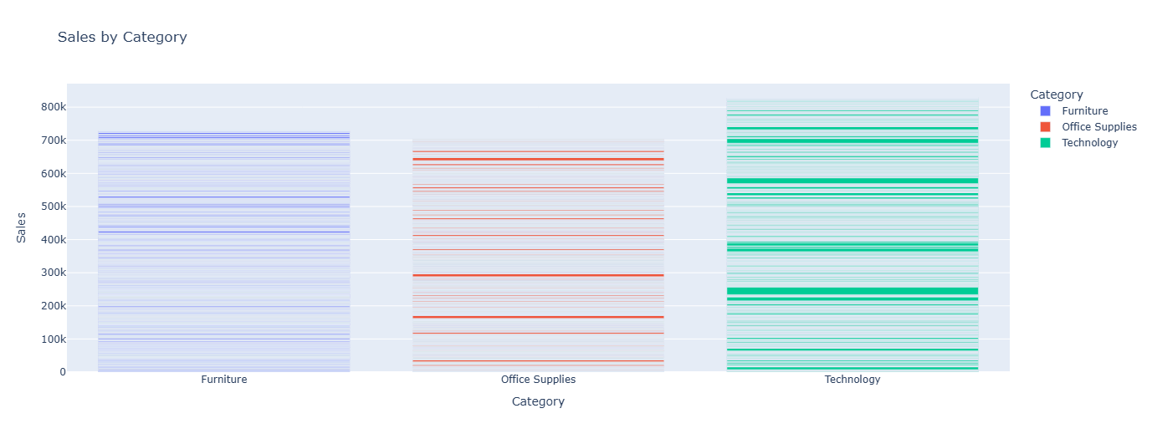
The bar chart compares total sales across the three main categories: Furniture, Office Supplies, and Technology.
It highlights which category contributes the most revenue overall.
Typically, Technology tends to generate higher sales compared to the other two, but this depends on the dataset.
This insight is useful for strategic decisions like which category to prioritize in promotions, marketing, and inventory planning.

Slide 5
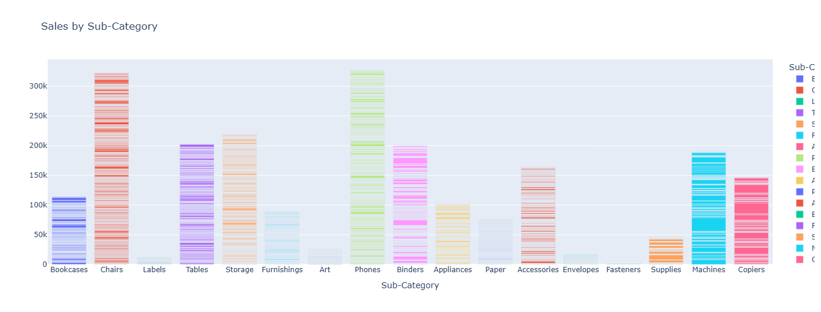
This chart breaks down sales performance within each category into specific sub-categories (e.g., Chairs, Phones, Binders).
It shows which product groups dominate overall revenue.
Typically, items like Phones and Chairs are among the top contributors, while smaller office supplies may generate less.
Insight: Businesses can use this to focus on high-performing sub-categories and improve strategies for weaker ones.

Slide 6
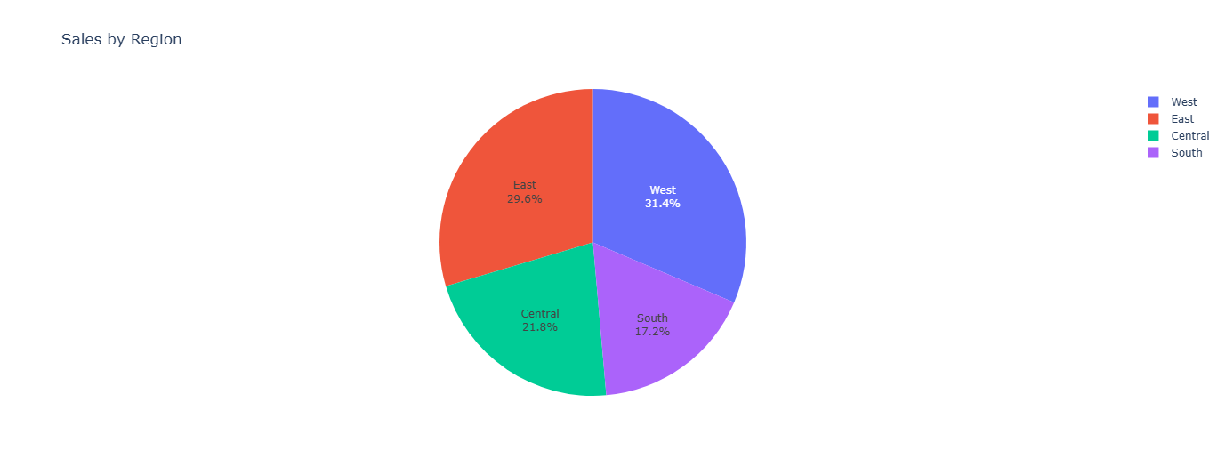
The pie chart shows the proportion of total sales contributed by each region (West, East, Central, South).
It highlights which region is the strongest market and which ones are weaker.
Typically, the West and East regions often dominate sales, while Central or South may contribute less.
This insight helps in geographic strategy: allocate resources, marketing, and logistics based on regional performance.

Slide 7
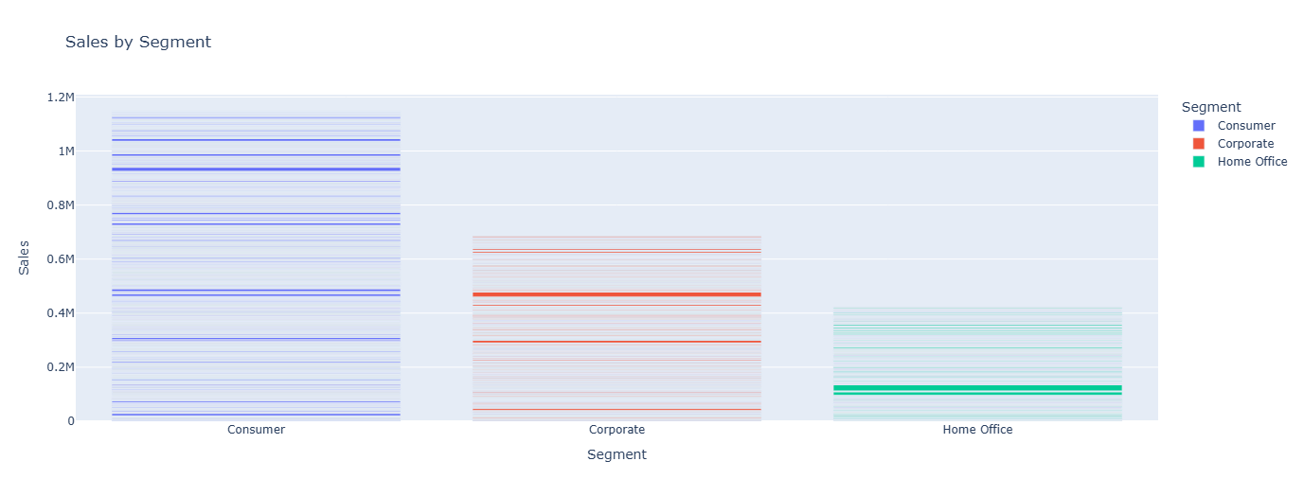
Identify which customer segment contributes the most to sales.
Helps in targeted marketing strategies.
Highlights potential over-dependence on a single segment, which could be a risk.

Slide 8
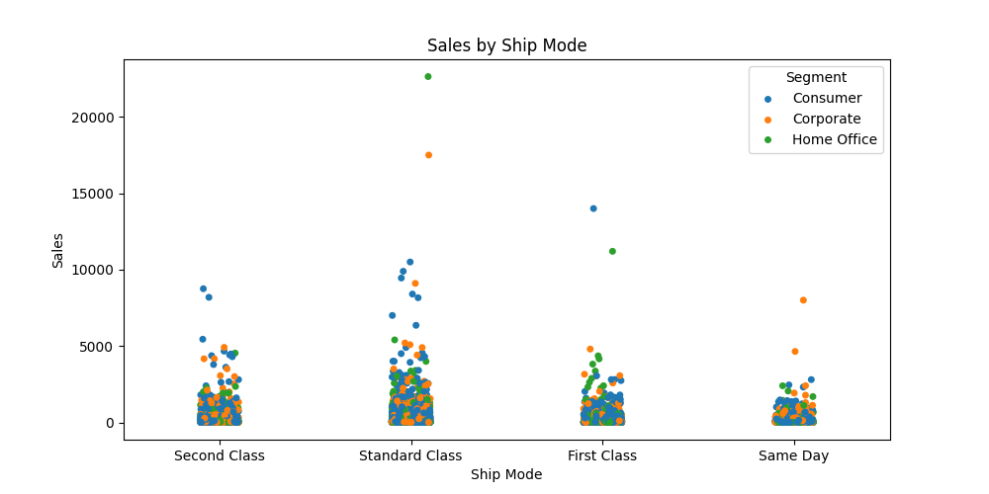
Shows how sales are distributed across different shipping modes.
Helps identify whether certain shipping methods are associated with higher or lower sales.
Outliers in the plot may indicate large or special orders using specific shipping methods.
Useful for understanding customer preferences and optimizing logistics or shipping strategies.

Slide 9
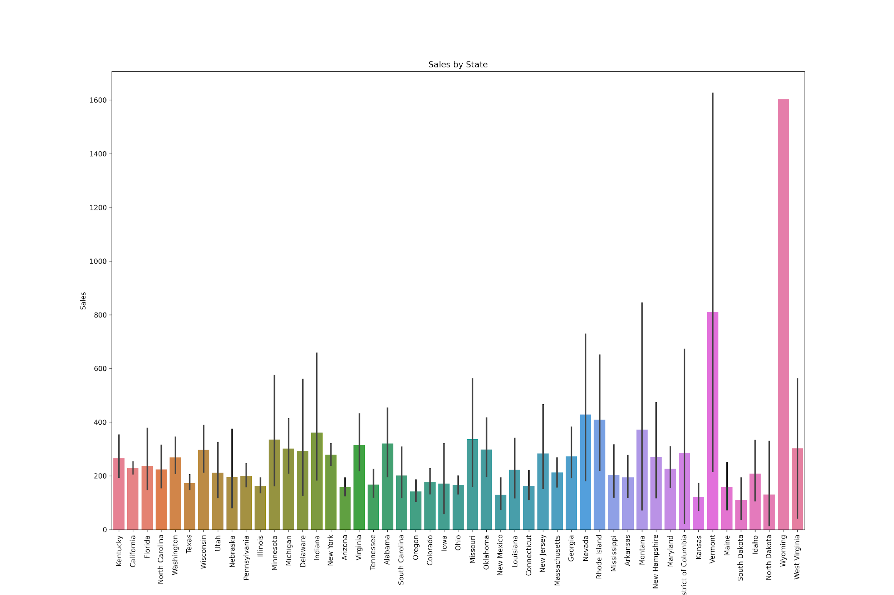
Shows how sales are distributed across different states.
Makes it easy to identify which states contribute the most to total sales.
Helps compare performance between states (top-performing vs low-performing).
Can guide decision-making in terms of regional strategies, marketing focus, or resource allocation.

Slide 10
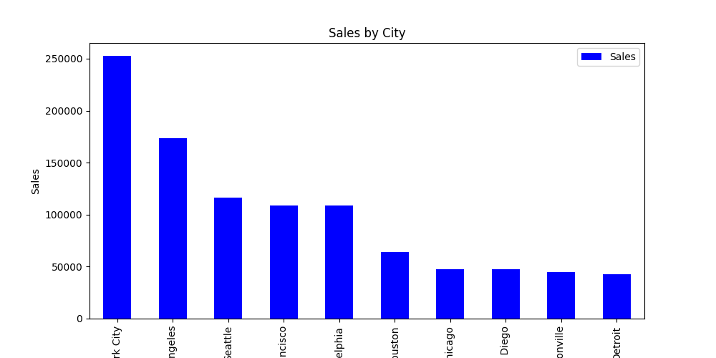
This chart highlights the top-performing cities in terms of sales. It helps identify where most of the revenue is concentrated, guiding decisions on where to focus marketing efforts, logistics, or expansion.

Slide 11
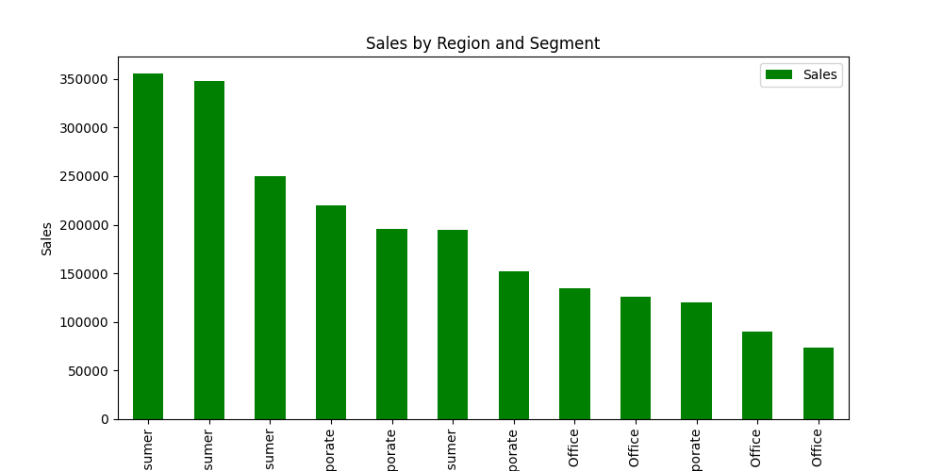
This visualization highlights how sales are distributed across different regions and customer segments.
It helps identify which combinations (e.g., East | Consumer or West | Corporate) contribute the most to total revenue.
Business teams can use this to focus on high-performing markets while addressing weaker areas.
It also supports strategic decisions for targeted marketing, resource allocation, and regional planning.

Slide 12
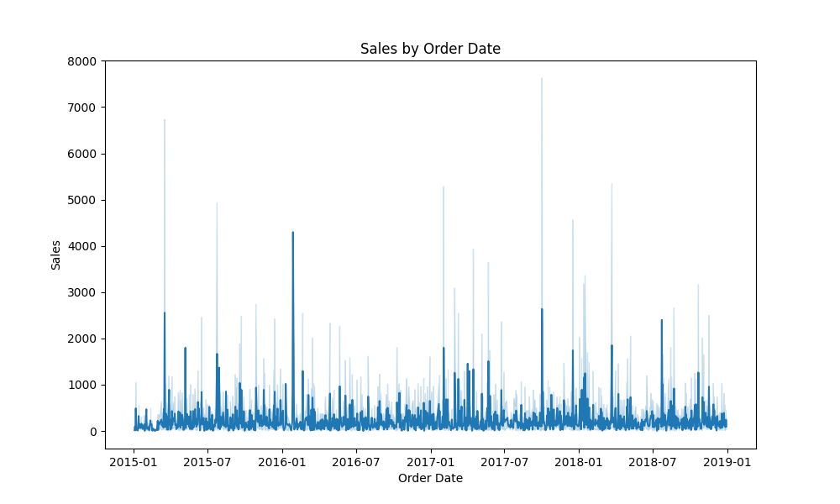
This line chart shows the trend of sales over time based on the order date. It highlights whether sales are increasing, decreasing, or fluctuating across different periods. Peaks in the chart may indicate seasonal demand or promotional effects, while dips may reflect off-peak times. This visualization is useful for identifying sales patterns, planning future strategies, and forecasting performance.

Slide 13
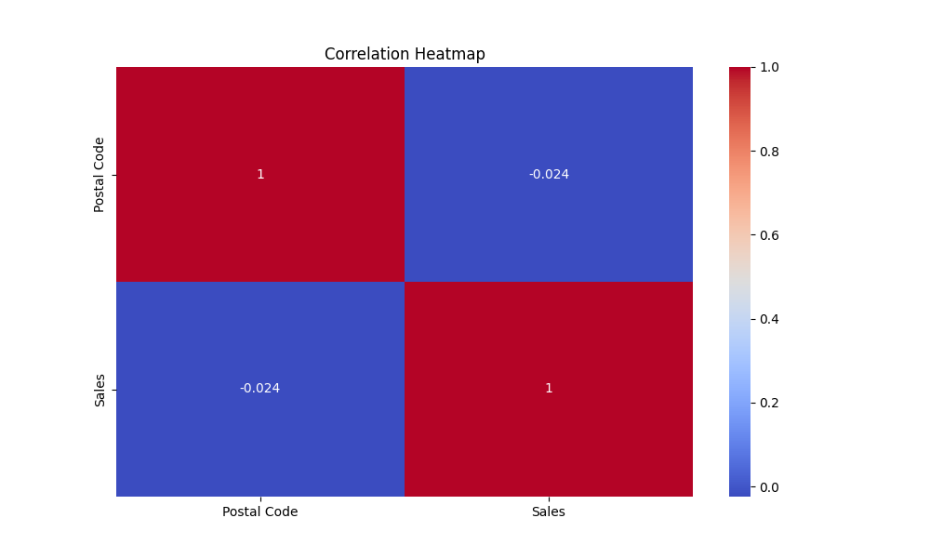
The correlation heatmap highlights the strength and direction of relationships between numerical features in the dataset.
Positive correlations (values close to +1) suggest that as one variable increases, the other also increases.
Negative correlations (values close to -1) indicate that as one variable increases, the other decreases.
Values near 0 represent weak or no linear relationship.
This visualization is useful for identifying patterns, detecting multicollinearity, and determining which variables most strongly influence sales.

Slide 14
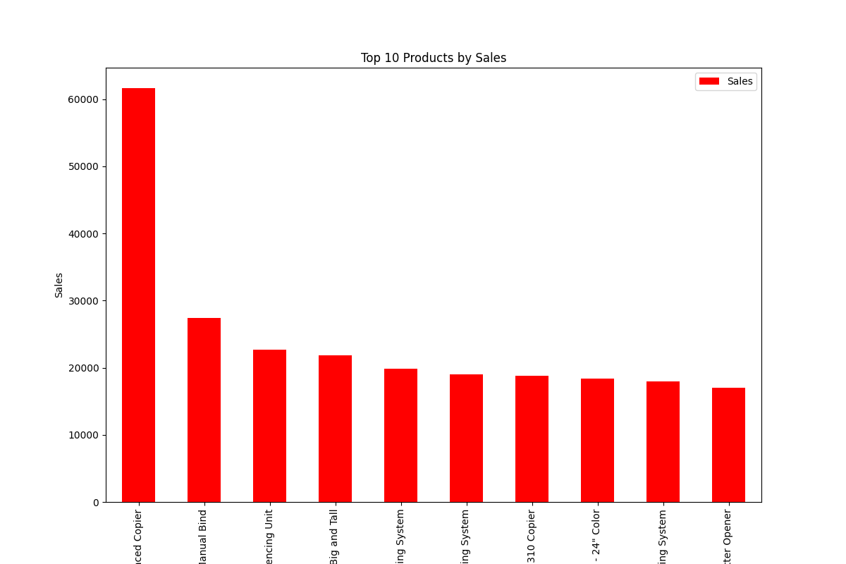
This chart highlights the top 10 products generating the highest sales. It helps identify which products contribute the most to overall revenue, enabling the business to prioritize inventory, marketing, and sales strategies around these key products."

Slide 15
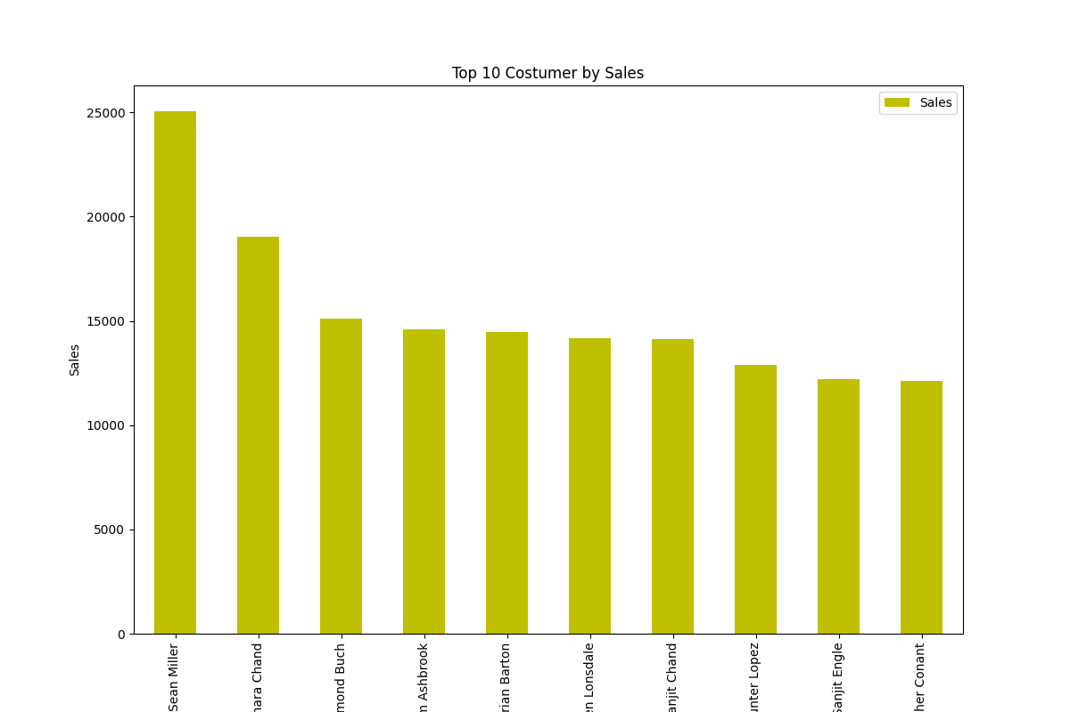
This chart shows the top 10 customers by total sales. It helps identify the most valuable customers, which is important for building loyalty programs, offering personalized promotions, and maintaining strong business relationships."

Slide 16
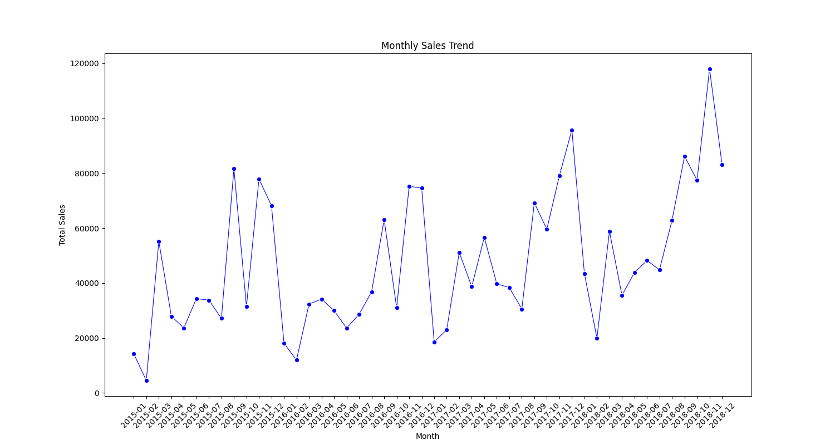
"This chart highlights the sales trend over time, helping to identify seasonal patterns, growth, or decline in performance."

Slide 17
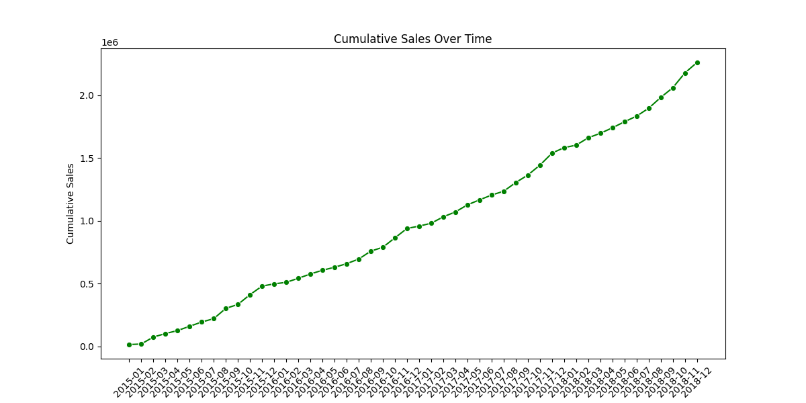
"This cumulative chart shows how sales accumulate over time, providing insights into overall growth."

Slide 18
Conclusion
From the analysis, we gained meaningful insights into the sales performance. We identified top-performing products and customers, regional sales variations, and trends over time. The visualizations highlighted clear differences between categories, segments, and regions, while the correlation analysis revealed important relationships between variables. Overall, this analysis provides a strong foundation for business decisions, helping in market positioning, customer targeting, and strategic planning.

Slide 19
Used Cars
(EDA)

Slide 20
Introduction
This report presents a comprehensive analysis of a car sales dataset. The dataset includes information about car characteristics (such as Car Type, Manufacturer, Color, Number of Seats, Number of Doors, Engine Power, Energy Type), pricing (Price-$, Margin-%), sales performance (Sales Rating, Sales Commission, Feedback, Sale Status), and other relevant features.
The aim of this analysis is to:
Understand the distribution of key numeric features like price, mileage, engine power, and margins.
Explore how different features influence car prices, such as Car Type, Manufacturer, Color, Number of Seats, Number of Doors, and Energy Type.
Identify top-performing cars and distributors.
Examine relationships between features using correlation analysis.
This analysis provides insights into pricing trends, customer preferences, and sales performance, which can inform strategic decisions for inventory management, pricing strategy, and marketing.

Slide 21
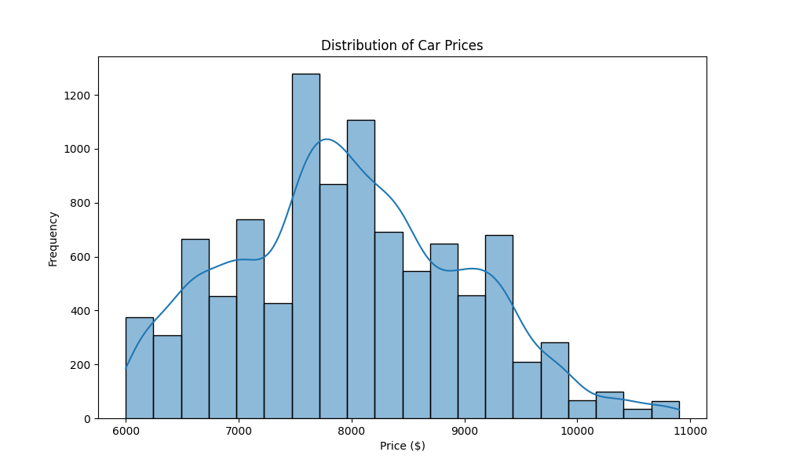
This histogram shows how car prices are distributed across the dataset:
Peaks indicate the most common price ranges for cars.
Prices might be skewed if there are very expensive or very cheap cars (outliers).
The KDE curve helps visualize the density of cars at different price points.
This gives an overview of the market pricing and helps identify typical vs. luxury cars.

Slide 22
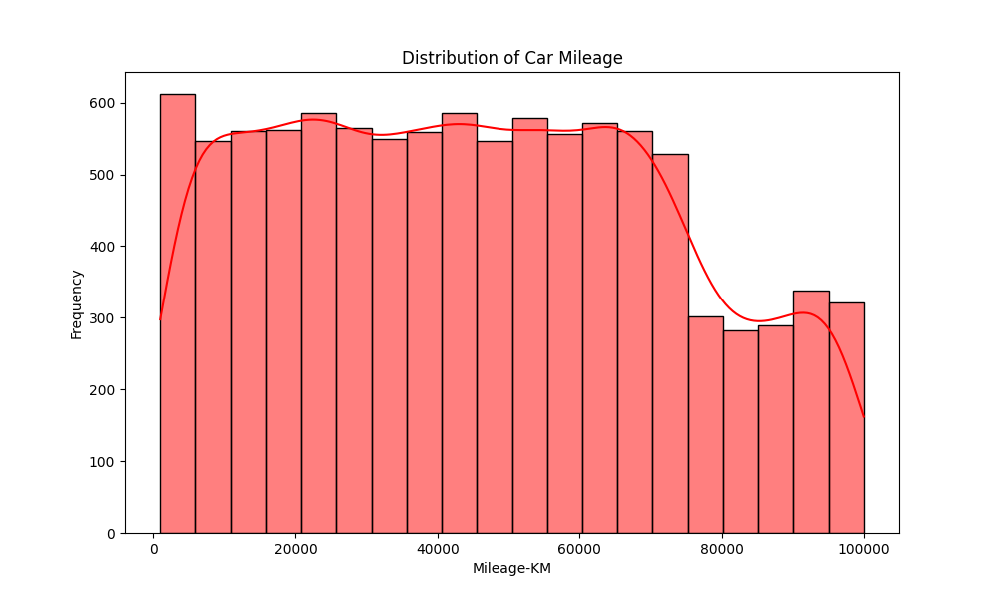
This histogram shows how car mileage is distributed in the dataset:
Peaks indicate the most common mileage ranges for the cars.
Low mileage cars are often newer or less used, while high mileage cars may be older or heavily used.
The KDE curve visualizes the density of cars at different mileage points.
This plot helps understand the usage profile of cars in the market.

Slide 23
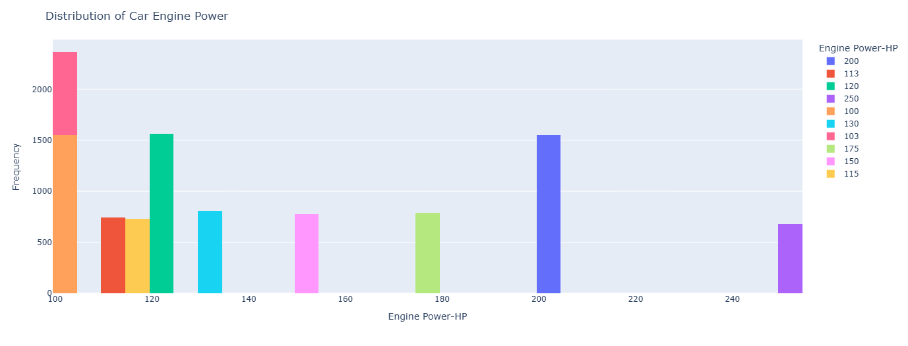
Shows how engine power is distributed across the dataset.
Peaks indicate the most common engine power ranges.
Cars with higher HP are usually premium or performance-oriented, while lower HP cars are economical or compact models.
Helps understand the market mix of car performance levels.

Slide 24
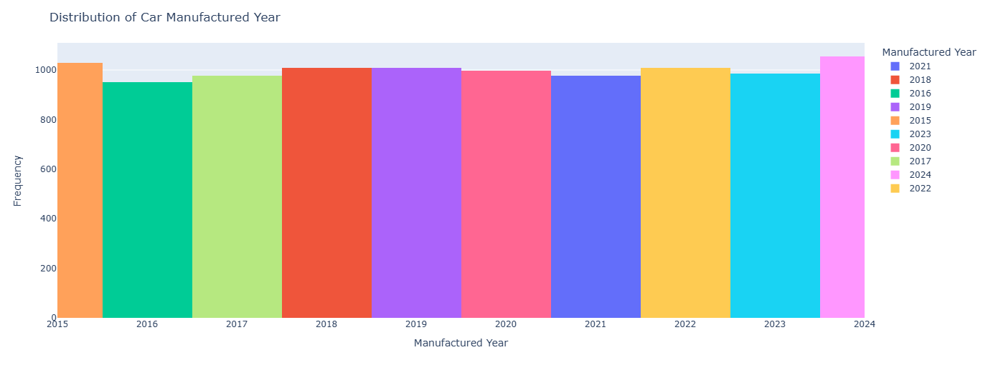
Shows how many cars were manufactured in each year from 2015 to 2024.
Peaks indicate the most common manufacturing years, i.e., years with higher availability in the dataset.
Helps understand market trends and the prevalence of newer vs older cars.
Useful for analyzing the age profile of cars and spotting trends in production or sales over time.

Slide 25
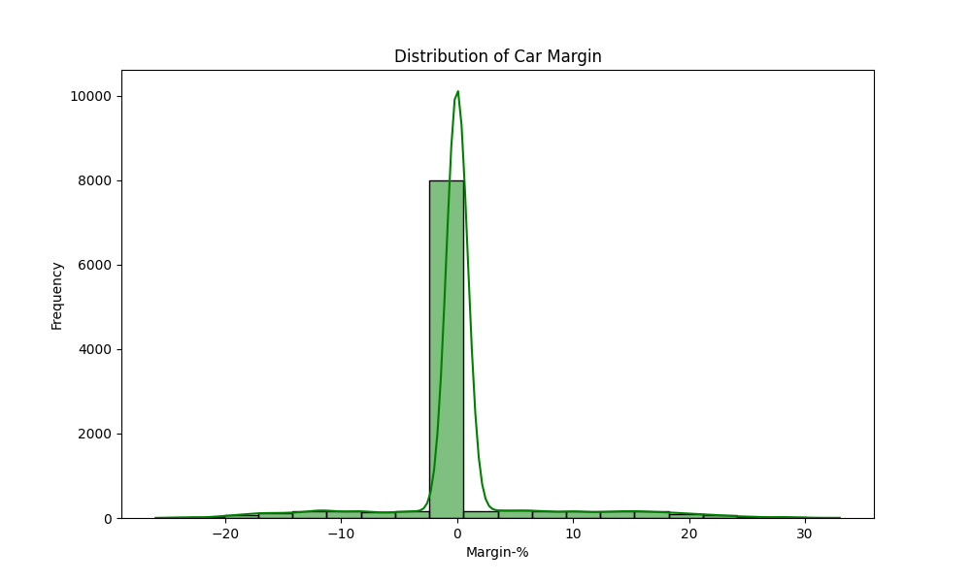
Shows how profit margins are distributed across all car sales.
Peaks indicate the most common margin ranges.
High margins usually correspond to premium cars or high-demand models, while low margins might indicate discounted or budget cars.
Helps understand profit patterns in the dealership or sales dataset.
Useful for identifying typical vs exceptional profit deals.

Slide 26
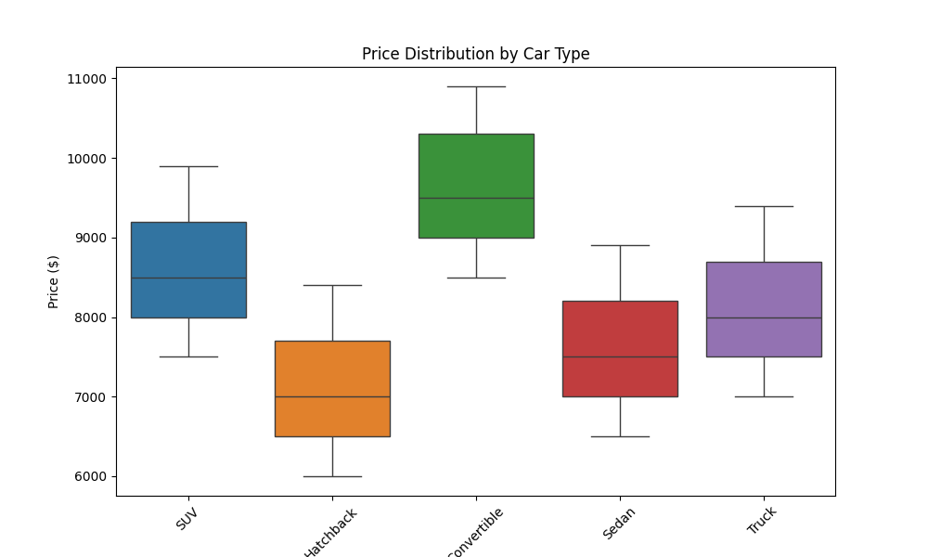
Shows how car price varies across different types (SUV, Sedan, Hatchback, etc.).
Each box represents the range of prices for that type: minimum, first quartile, median, third quartile, and maximum.
Outliers (individual points outside the box) indicate exceptionally high or low prices for a specific type.
Helps identify which car types are generally more expensive and which are more budget-friendly.
Useful for understanding market trends and planning sales or promotions.

Slide 27
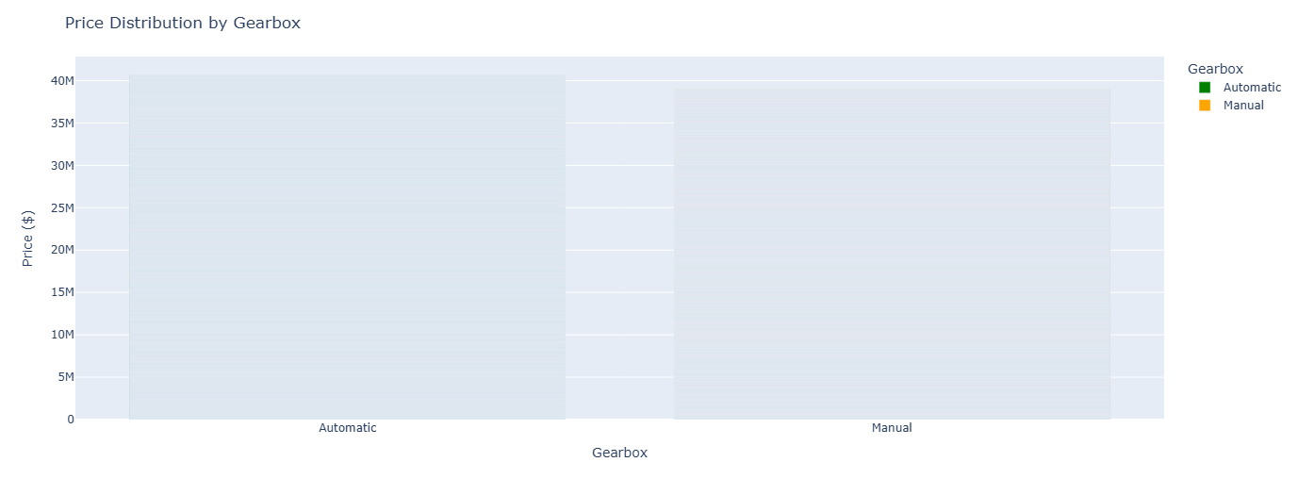
Shows how car prices differ between Manual and Automatic gearboxes.
Helps identify if automatic cars are generally more expensive than manual ones.
Each bar represents the average or total price (حسب الإعدادات) for that gearbox type.
Useful for understanding customer preferences and pricing trends related to transmission type.

Slide 28
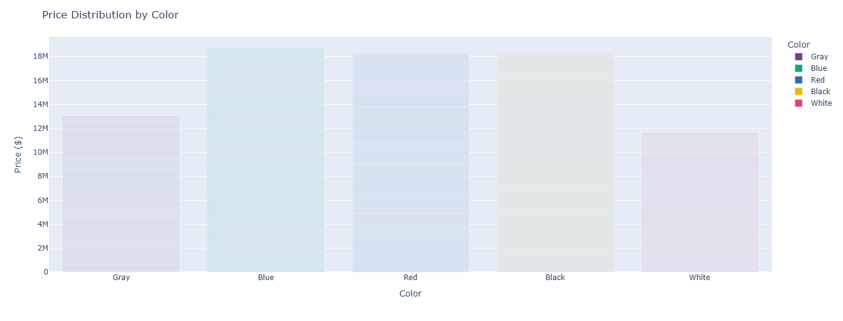
Shows how car prices vary by color.
Each bar represents the average or total price for cars of that color.
Helps identify if certain colors tend to be more expensive in the market.
Using vibrant colors makes it easier to distinguish categories and improves visualization clarity.

Slide 29
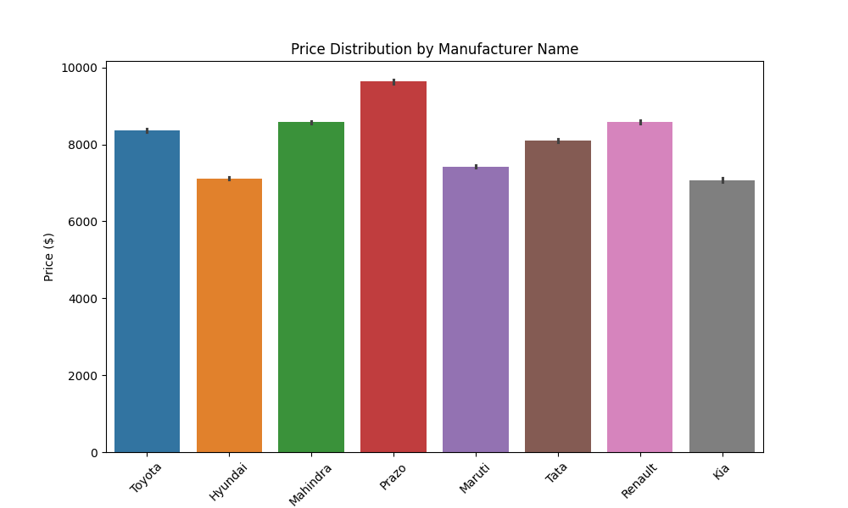
Shows how car prices vary across different manufacturers.
Helps identify premium brands vs economical brands.
Each bar represents the average price for that manufacturer.
Outliers or large differences may indicate specific models that are significantly more expensive within the same brand.
Useful for market positioning analysis and understanding brand pricing trends.

Slide 30
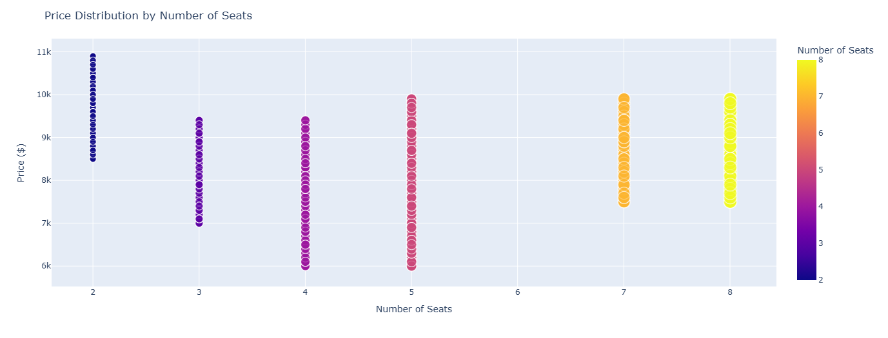
Shows how car price varies with the number of seats.
Each point represents a car, sized and colored by seat count.
Helps identify if larger cars (more seats) are generally more expensive.
Outliers indicate cars that are significantly cheaper or more expensive than typical for their seat count.
Useful for understanding market trends in vehicle size and pricing.

Slide 31
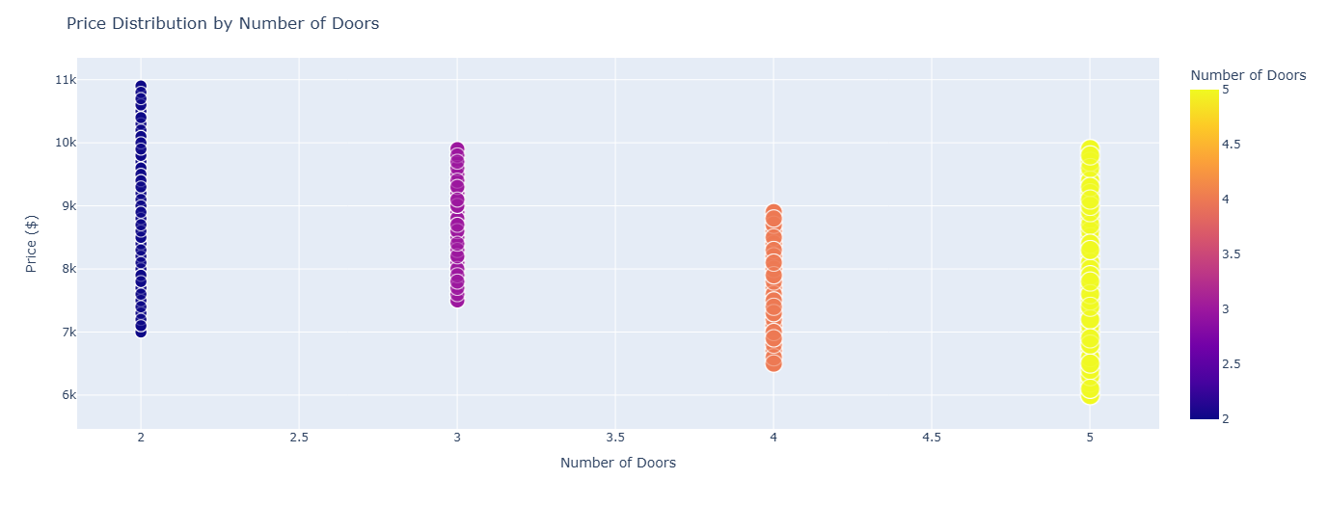
Shows how car price varies with the number of doors.
Each point represents a car, sized and colored by number of doors.
Helps identify if cars with more doors tend to be more expensive, or if door count has little effect on price.
Outliers indicate specific models priced unusually high or low for their door count.
Useful for analyzing vehicle design and pricing patterns.

Slide 32
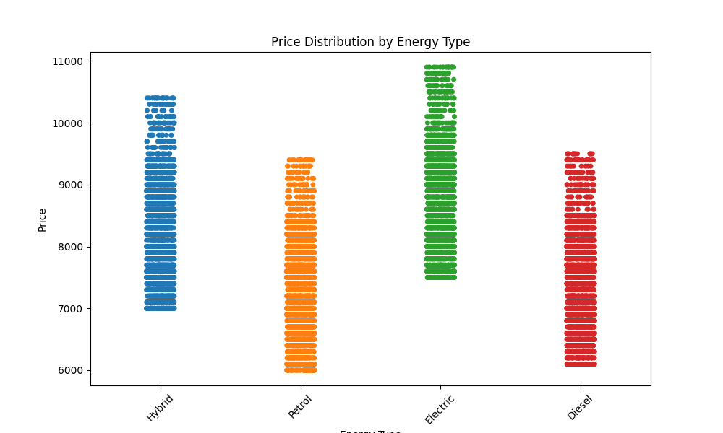
Shows how car price varies by energy type (Gasoline, Diesel, Electric, Hybrid, etc.).
Each point represents a car, with color showing its energy type.
Helps identify if electric or hybrid cars tend to be more expensive than traditional fuel cars.
Outliers indicate cars that are significantly cheaper or more expensive than typical for their energy type.
Useful for analyzing the impact of fuel type on pricing and market trends.

Slide 33
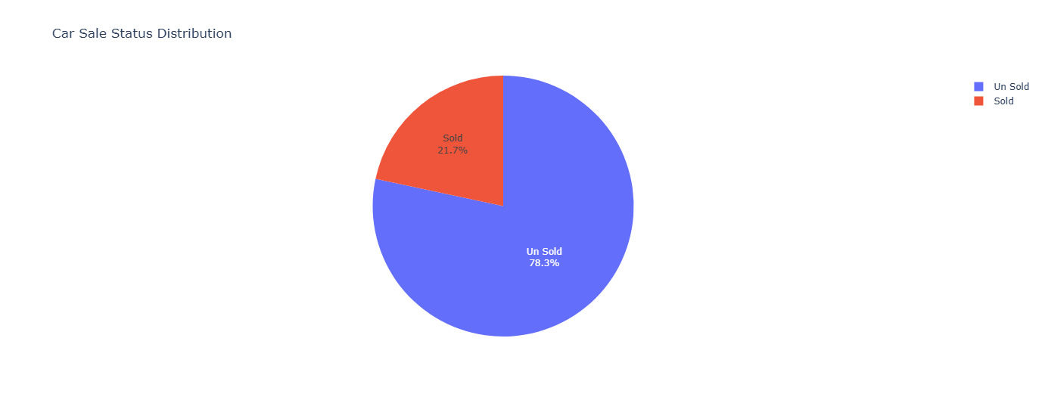
Shows the proportion of cars in each sale status (Sold, Available, Reserved, etc.).
Each slice represents the percentage of cars in that category.
Helps identify how many cars have been sold vs still available.
Useful for inventory analysis and understanding the sales performance of the dealership.

Slide 34
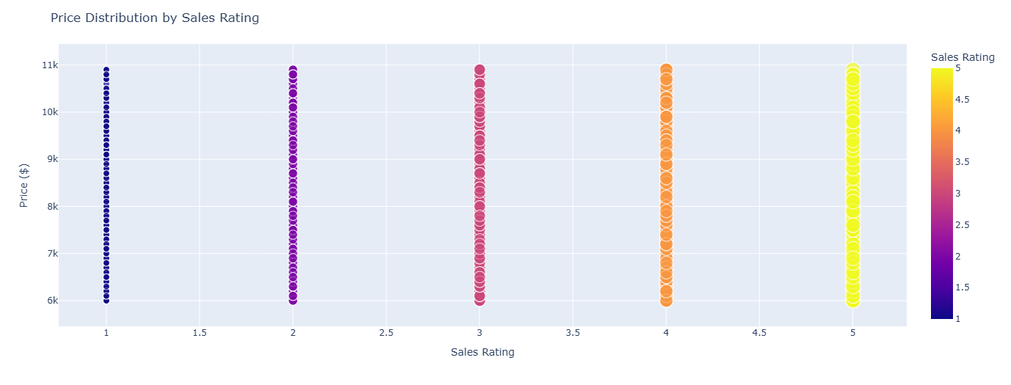
Shows how car price varies with the sales rating of the sales agent.
Each point represents a car, sized and colored by Sales Rating.
Helps identify if higher-rated sales agents tend to sell higher-priced cars.
Outliers indicate cars that were sold at unusually high or low prices relative to the sales rating.
Useful for analyzing the impact of sales agent performance on pricing and sales outcomes.

Slide 35
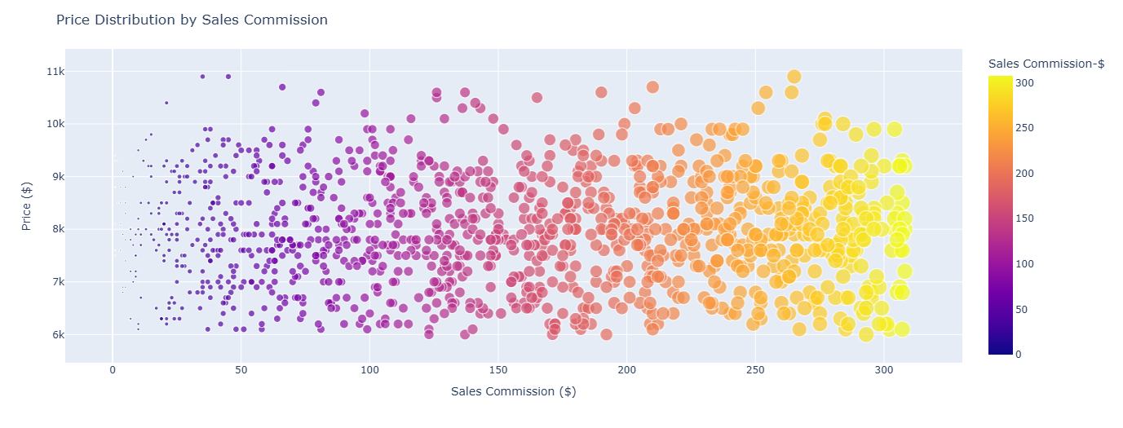
Shows how car price varies with the sales commission received by the agent.
Each point represents a car, sized and colored by Sales Commission.
Helps identify if higher-priced cars lead to higher commissions.
Outliers indicate cars with unusually high or low commissions relative to their price.
Useful for analyzing the relationship between pricing and sales incentives.

Slide 36
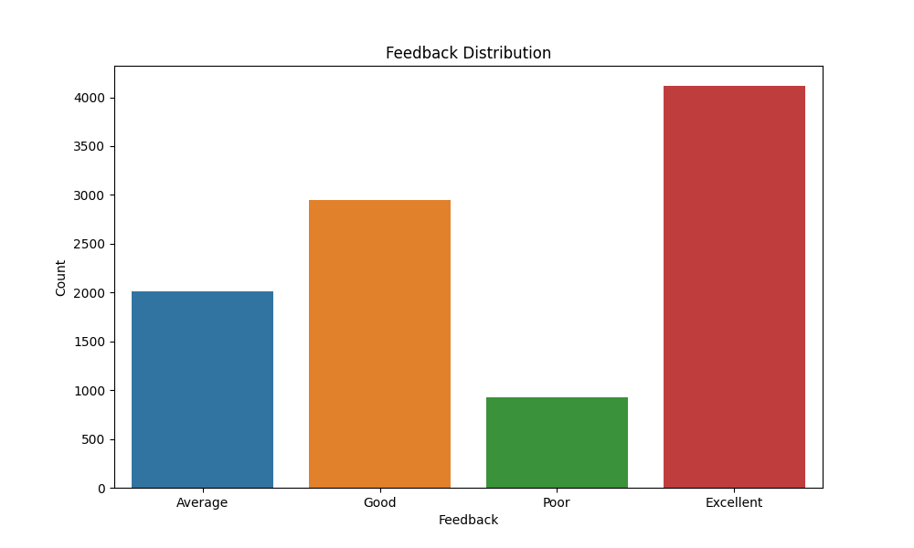
Shows the count of cars for each feedback category (Positive, Neutral, Negative, etc.).
Each bar represents the number of cars with that feedback.
Helps identify the overall customer satisfaction trend in the dataset.
Useful for assessing sales performance and customer experience.

Slide 37
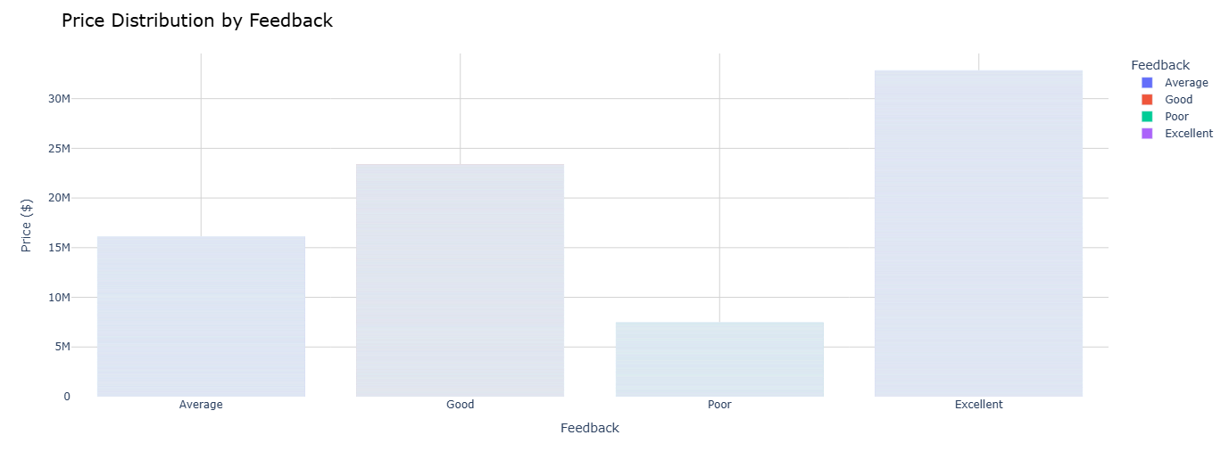
Shows how car prices vary with customer feedback (Positive, Neutral, Negative, etc.).
Each bar represents the average or total price for cars in that feedback category.
Helps identify if higher-priced cars tend to receive better feedback.
Outliers indicate cars with unusual pricing relative to feedback.
Useful for analyzing the relationship between pricing and customer satisfaction.

Slide 38
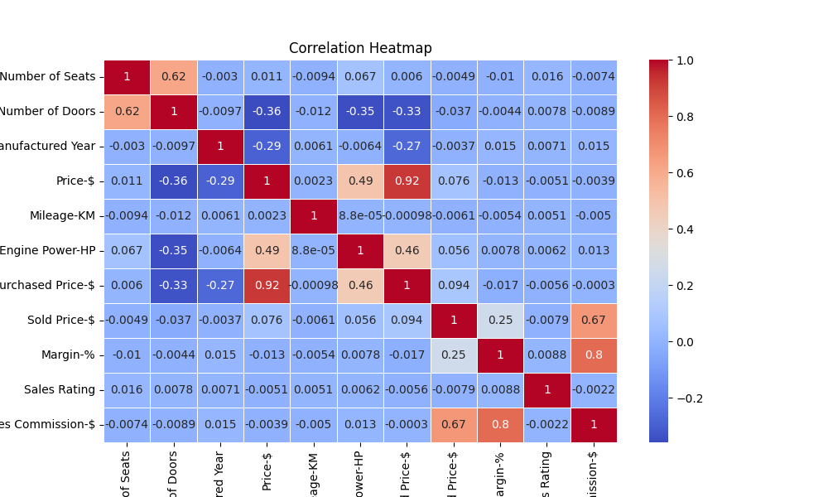
Shows the strength and direction of linear relationships between numeric features (Price-$, Mileage-KM, Engine Power-HP, Margin-%).
Positive correlation (close to +1): when one feature increases, the other tends to increase.
Negative correlation (close to -1): when one feature increases, the other tends to decrease.
Values near 0: little or no linear relationship.
Helps identify key factors influencing price and guide further analysis.

Slide 39
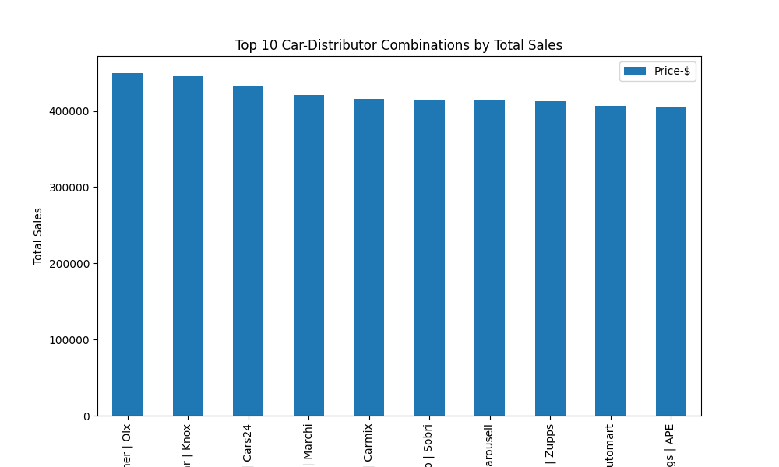
Shows the 10 cars with the highest total prices in the dataset.
Each bar represents a car name combined with its distributor.
Helps identify most valuable cars and key distributors.
Useful for sales strategy, inventory prioritization, and highlighting high-value products.

Slide 40
Conclusion
The analysis highlights several important findings:
Price distribution varies significantly with Car Type, Manufacturer, Number of Seats, Number of Doors, and Energy Type.
Premium brands and larger vehicles tend to have higher prices.
Customer feedback, sales rating, and sales commission are associated with price trends, indicating the influence of sales performance on pricing.
Correlation analysis identifies key factors affecting price, such as Engine Power and Mileage.
Top 10 cars by total price reveal the most valuable vehicles and distributors in the dataset.
Overall, these insights can help the dealership or business optimize pricing, improve sales strategies, and better understand customer preferences.

Slide 41
LONDON HOUSES
(EDA)

Slide 42

THIS REPORT PRESENTS A COMPREHENSIVE ANALYSIS OF THE REAL ESTATE DATASET, EXPLORING THE RELATIONSHIPS BETWEEN PROPERTY FEATURES AND PRICES. USING VARIOUS DATA VISUALIZATION TECHNIQUES SUCH AS BAR CHARTS, BOXPLOTS, VIOLIN PLOTS, SCATTER PLOTS, HISTOGRAMS, AND HEATMAPS, WE AIM TO:
UNDERSTAND THE DISTRIBUTION OF KEY FEATURES LIKE PRICE, SQUARE METERS, AND BUILDING AGE.
IDENTIFY RELATIONSHIPS BETWEEN PROPERTY CHARACTERISTICS (BEDROOMS, BATHROOMS, VIEW, GARDEN, BALCONY, HEATING TYPE) AND PRICE.
HIGHLIGHT TOP-PERFORMING PROPERTIES AND NEIGHBORHOODS, PROVIDING INSIGHTS INTO THE LUXURY SEGMENT.
DETECT PATTERNS, CORRELATIONS, AND OUTLIERS THAT INFLUENCE PROPERTY VALUES.
THE ANALYSIS PROVIDES VALUABLE INSIGHTS FOR INVESTORS, BUYERS, AND MARKET ANALYSTS TO MAKE INFORMED DECISIONS.
Introduction

Slide 43
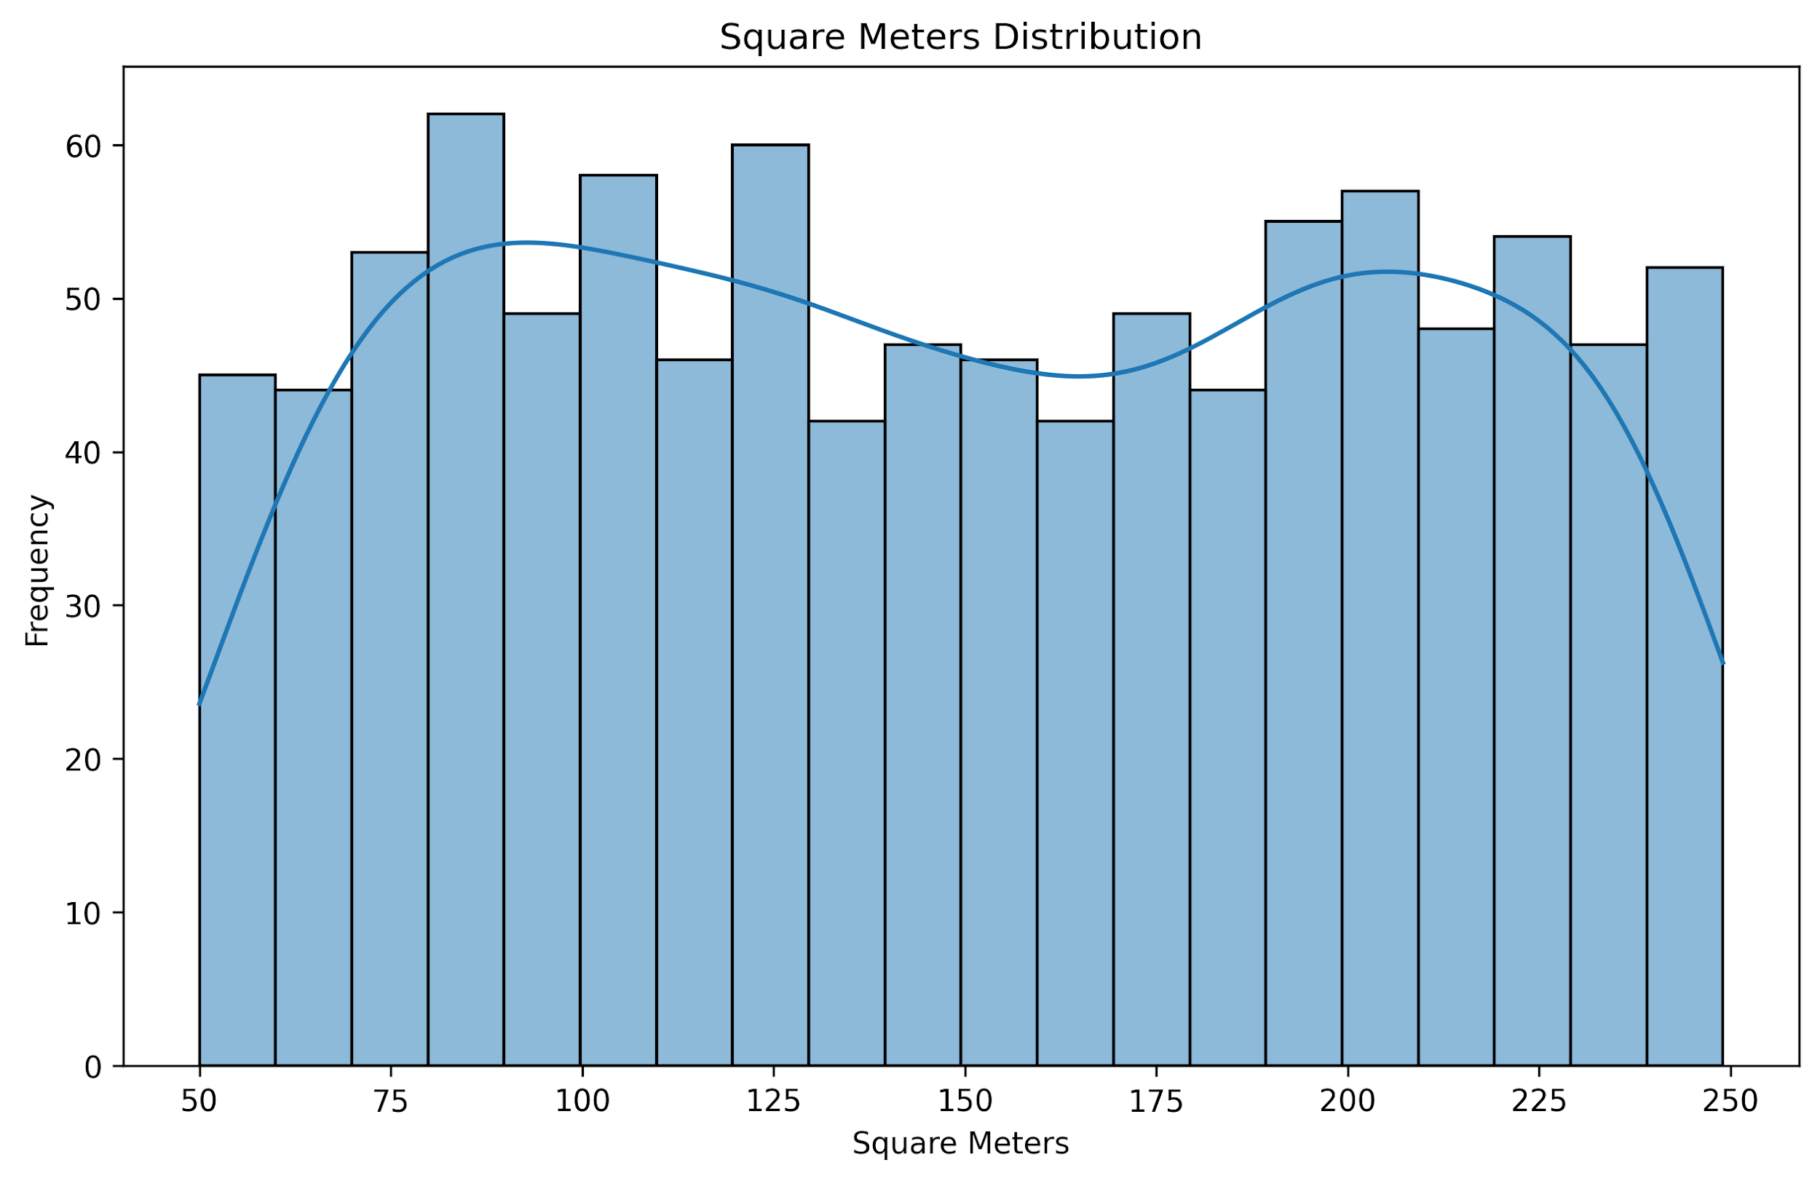
THE HISTOGRAM SHOWS THE OVERALL DISTRIBUTION OF PROPERTY SIZES. MOST PROPERTIES ARE CONCENTRATED WITHIN A COMMON SIZE RANGE, WHILE FEWER PROPERTIES FALL AT THE EXTREMES. THE SHAPE OF THE CURVE HELPS IDENTIFY WHETHER THE DISTRIBUTION IS BALANCED OR SKEWED, AND IT ALSO HIGHLIGHTS THE PRESENCE OF UNUSUAL PROPERTY SIZES THAT OCCUR LESS FREQUENTLY.

Slide 44
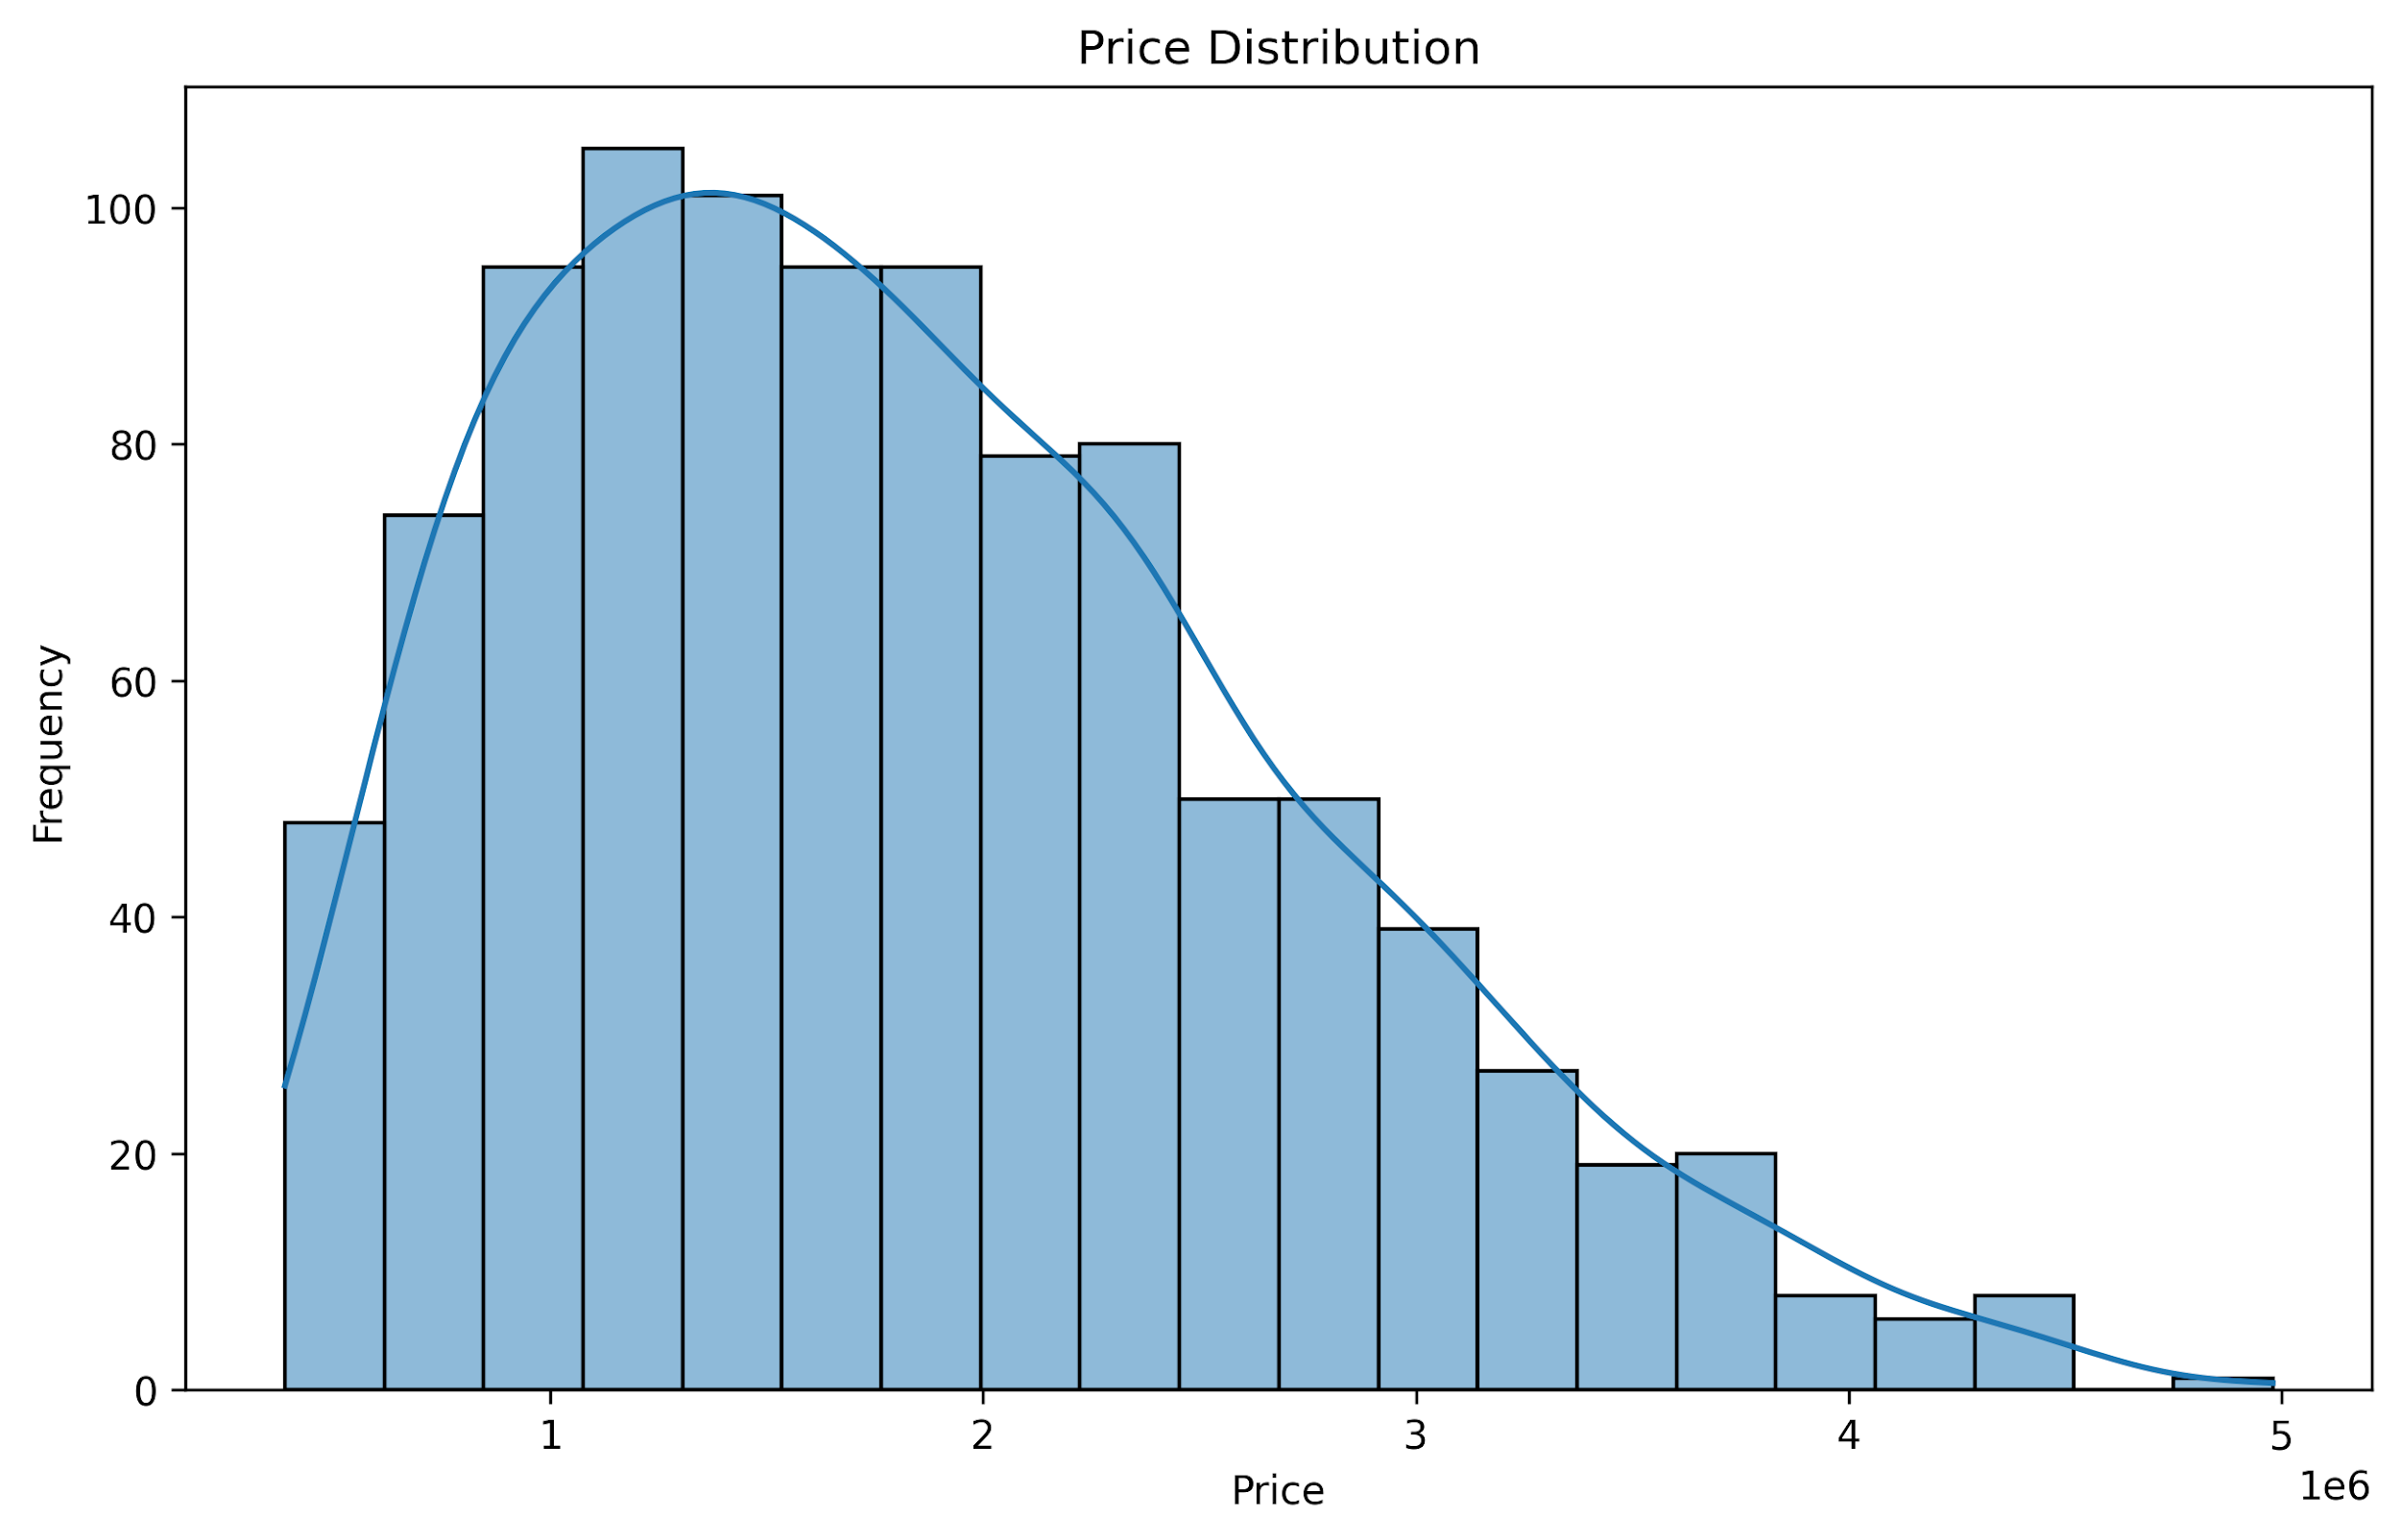
THE HISTOGRAM ILLUSTRATES THE OVERALL DISTRIBUTION OF PROPERTY PRICES. MOST PROPERTIES FALL WITHIN A CERTAIN PRICE RANGE, WHILE FEWER PROPERTIES APPEAR AT THE VERY HIGH OR VERY LOW ENDS OF THE SCALE. THE CURVE HIGHLIGHTS WHETHER THE MARKET IS BALANCED OR SKEWED, AND IT ALSO SHOWS THE PRESENCE OF RARE, HIGH-VALUE PROPERTIES THAT STAND OUT AS OUTLIERS.

Slide 45
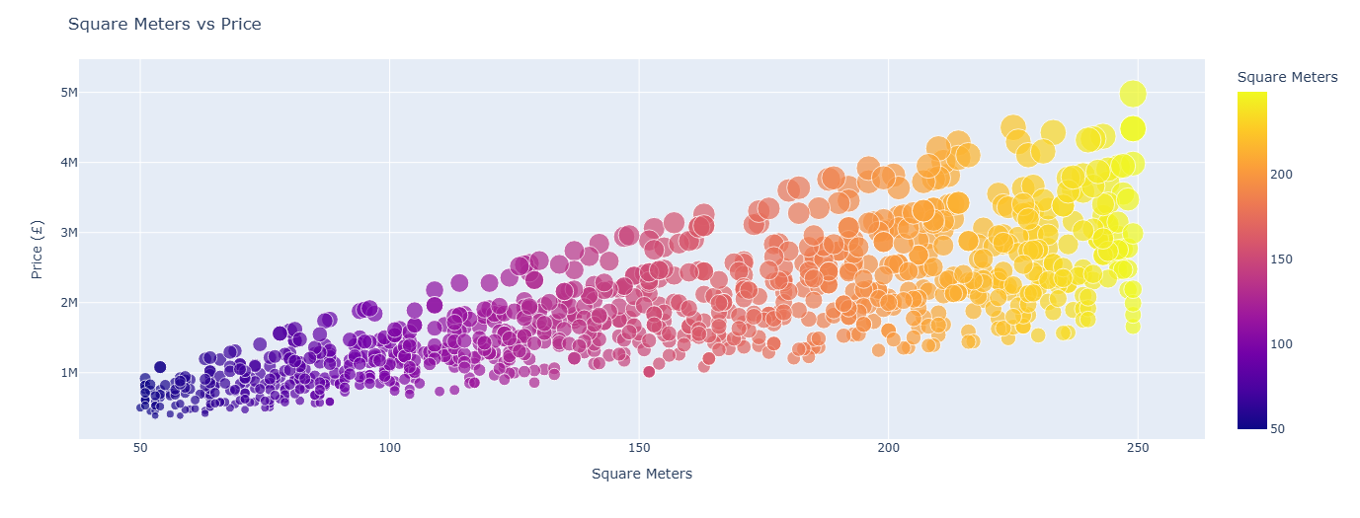
THE SCATTER PLOT SHOWS THE RELATIONSHIP BETWEEN PROPERTY SIZE AND PRICE. IN GENERAL, THERE IS A POSITIVE TREND, MEANING THAT LARGER PROPERTIES TEND TO HAVE HIGHER PRICES. AT THE SAME TIME, THE PLOT HIGHLIGHTS POTENTIAL OUTLIERS, SUCH AS SMALL PROPERTIES WITH UNEXPECTEDLY HIGH PRICES OR LARGE PROPERTIES PRICED LOWER THAN EXPECTED. THIS VISUALIZATION HELPS CONFIRM THE OVERALL MARKET TREND WHILE IDENTIFYING UNUSUAL CASES.

Slide 46
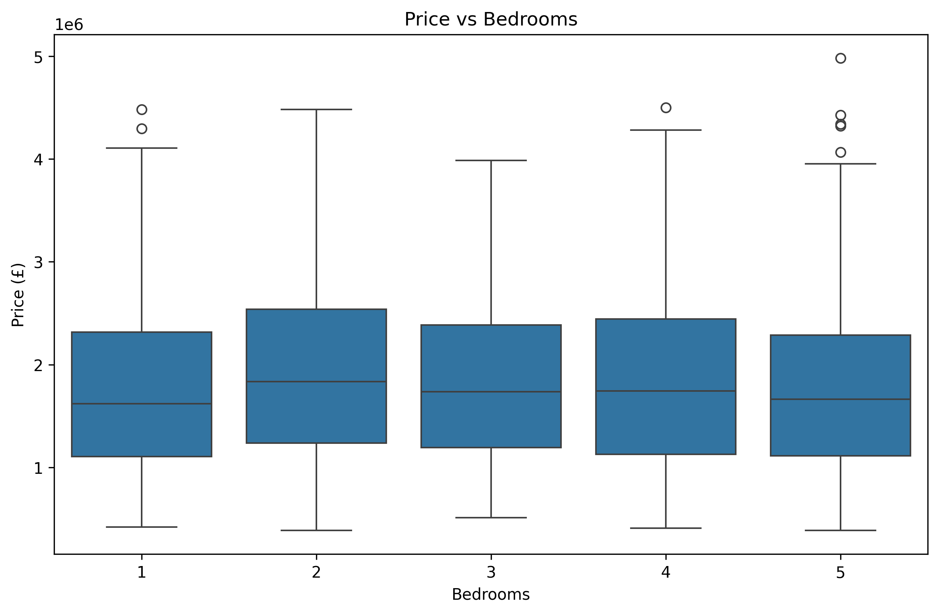
THE BOXPLOT ILLUSTRATES HOW PROPERTY PRICES VARY WITH THE NUMBER OF BEDROOMS. IN GENERAL, PROPERTIES WITH MORE BEDROOMS TEND TO HAVE HIGHER PRICES, REFLECTING THEIR LARGER SIZE AND ADDED VALUE. HOWEVER, THE PLOT ALSO SHOWS OVERLAPS BETWEEN CATEGORIES, MEANING THAT SOME SMALLER PROPERTIES MAY BE MORE EXPENSIVE THAN LARGER ONES DUE TO FACTORS SUCH AS LOCATION, QUALITY, OR SPECIAL FEATURES. THE PRESENCE OF OUTLIERS HIGHLIGHTS UNIQUE CASES, SUCH AS VERY EXPENSIVE LUXURY HOMES THAT DO NOT FOLLOW THE GENERAL TREND.

Slide 47
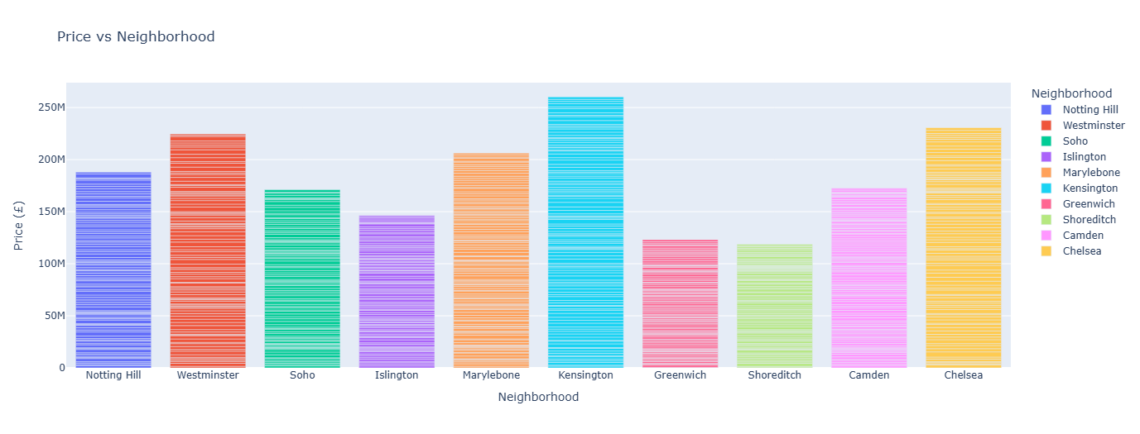
THE BAR CHART COMPARES PROPERTY PRICES ACROSS DIFFERENT NEIGHBORHOODS. IT HIGHLIGHTS WHICH AREAS ARE GENERALLY MORE EXPENSIVE AND WHICH ARE MORE AFFORDABLE. HIGH-PRICE NEIGHBORHOODS MAY INDICATE PRIME LOCATIONS WITH BETTER INFRASTRUCTURE OR PRESTIGE, WHILE LOWER-PRICE AREAS COULD REPRESENT MORE BUDGET-FRIENDLY OR LESS DEVELOPED REGIONS. THIS VISUALIZATION PROVIDES INSIGHTS INTO HOW LOCATION SIGNIFICANTLY INFLUENCES PROPERTY VALUES.

Slide 48
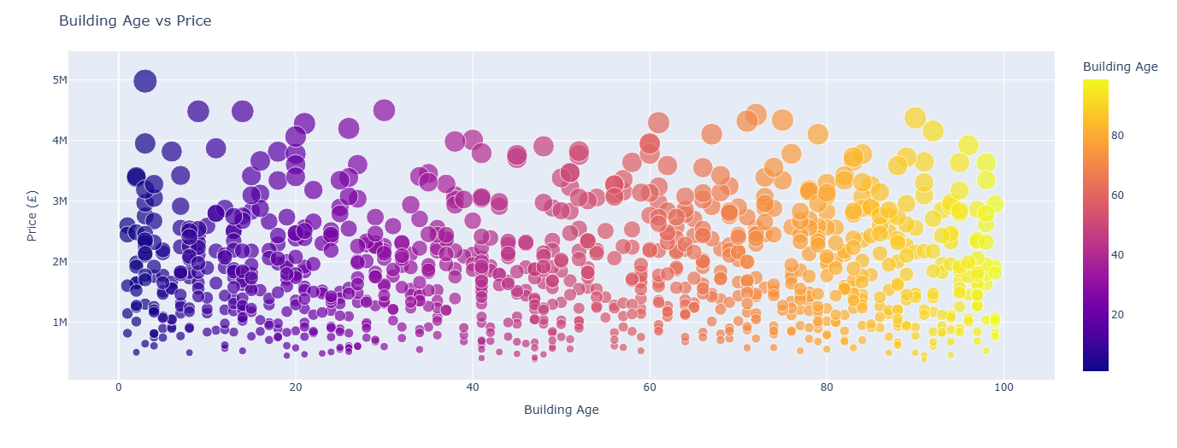
THIS SCATTER PLOT SHOWS HOW PROPERTY PRICES VARY WITH BUILDING AGE.
NEWER BUILDINGS OFTEN ATTRACT HIGHER PRICES DUE TO MODERN DESIGN, BETTER MATERIALS, AND LESS NEED FOR RENOVATION.
OLDER BUILDINGS MAY SHOW LOWER PRICES, UNLESS THEY ARE IN PRIME LOCATIONS OR HAVE HISTORICAL VALUE.
OUTLIERS (VERY EXPENSIVE BUT OLD, OR VERY CHEAP BUT NEW) CAN INDICATE UNIQUE CASES SUCH AS LUXURY RENOVATIONS OR POOR LOCATIONS.
THIS VISUALIZATION HELPS UNDERSTAND WHETHER BUYERS TEND TO PAY MORE FOR NEWER CONSTRUCTIONS OR IF LOCATION OUTWEIGHS AGE.

Slide 49
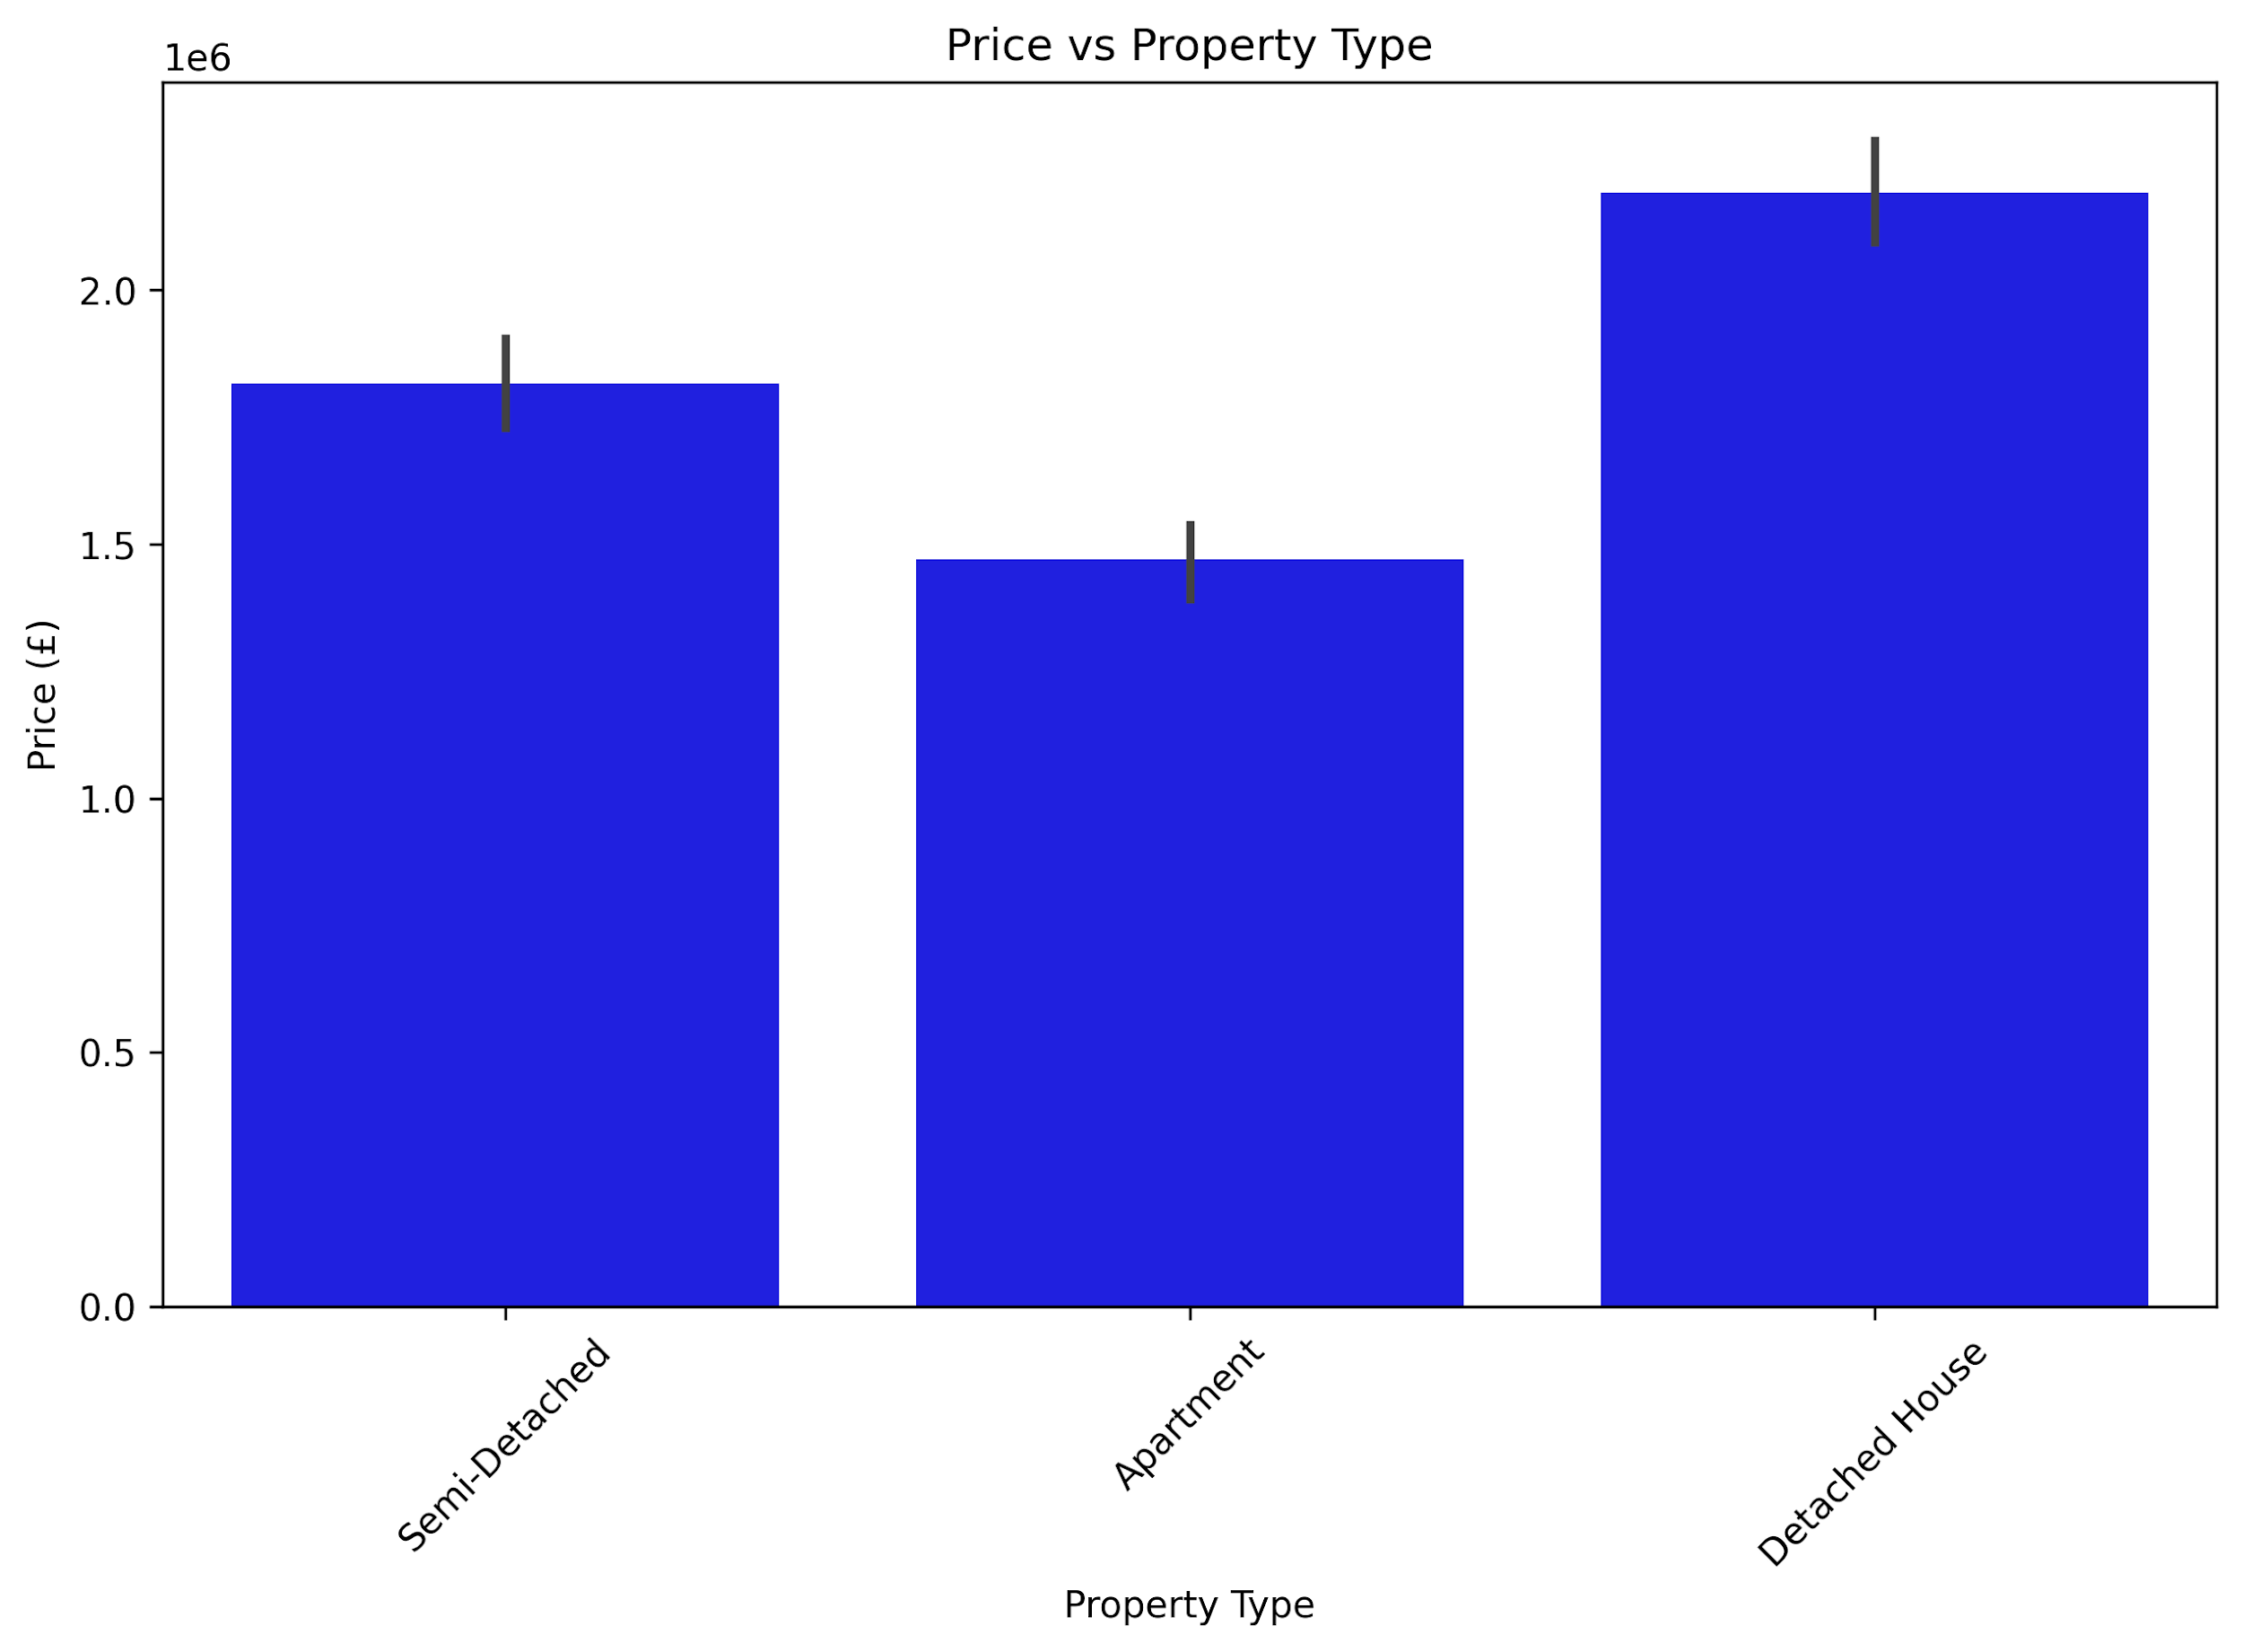
THIS BAR CHART COMPARES THE AVERAGE PROPERTY PRICES ACROSS DIFFERENT PROPERTY TYPES.
CERTAIN PROPERTY TYPES (E.G., VILLAS OR DUPLEXES) MAY SHOW SIGNIFICANTLY HIGHER AVERAGE PRICES, REFLECTING LARGER SIZES OR MORE LUXURY FEATURES.
OTHER TYPES (E.G., APARTMENTS OR STUDIOS) TEND TO BE MORE AFFORDABLE, APPEALING TO BUDGET-CONSCIOUS BUYERS OR RENTERS.
THE CHART HELPS IDENTIFY WHICH PROPERTY TYPES DOMINATE THE HIGH-END MARKET AND WHICH REPRESENT MORE ACCESSIBLE HOUSING OPTIONS.

Slide 50
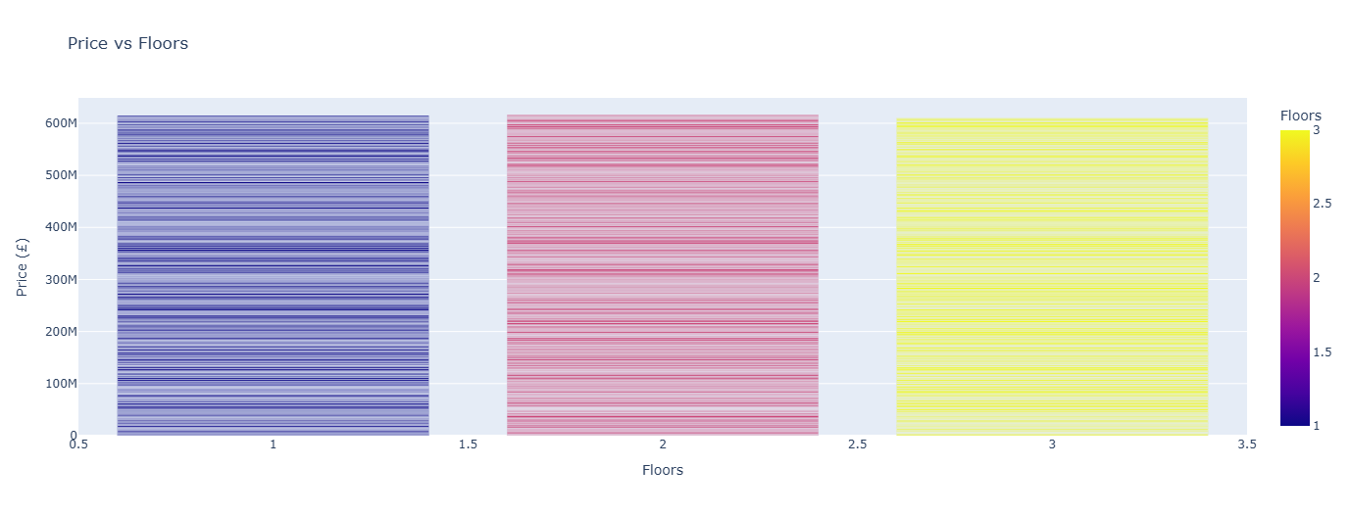
THIS BAR CHART ILLUSTRATES HOW PROPERTY PRICES VARY WITH THE NUMBER OF FLOORS.
PROPERTIES WITH MORE FLOORS MAY INDICATE LARGER HOUSES OR VILLAS, OFTEN ASSOCIATED WITH HIGHER PRICES.
LOWER-FLOOR PROPERTIES (LIKE SINGLE-FLOOR APARTMENTS OR HOUSES) MAY SHOW MORE AFFORDABLE PRICING.
THE TREND CAN REVEAL WHETHER BUYERS PAY A PREMIUM FOR MULTI-STORY PROPERTIES, OR IF FLOOR COUNT HAS LIMITED IMPACT COMPARED TO OTHER FACTORS (LIKE LOCATION OR SIZE).

Slide 51
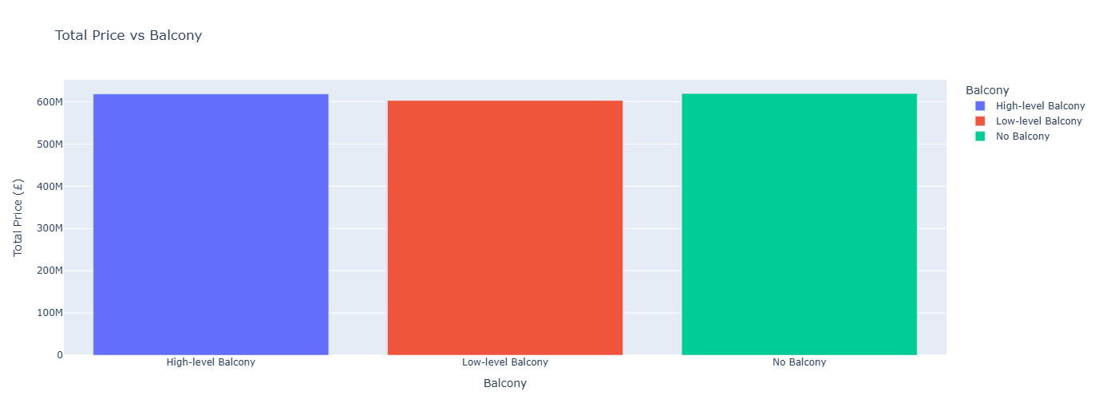
THIS CHART SHOWS THE TOTAL COMBINED PROPERTY PRICES FOR HOMES WITH AND WITHOUT BALCONIES.
IF THE TOTAL PRICE FOR PROPERTIES WITH BALCONIES IS MUCH HIGHER, IT MAY INDICATE THAT MOST HIGH-VALUE PROPERTIES TEND TO INCLUDE BALCONIES.
IF THE TOTALS ARE CLOSE, IT SUGGESTS BALCONIES DO NOT STRONGLY INFLUENCE THE OVERALL PROPERTY MARKET DISTRIBUTION.
THIS VISUALIZATION REFLECTS THE AGGREGATE MARKET VALUE DISTRIBUTION BETWEEN PROPERTIES BASED ON THE BALCONY FEATURE.

Slide 52
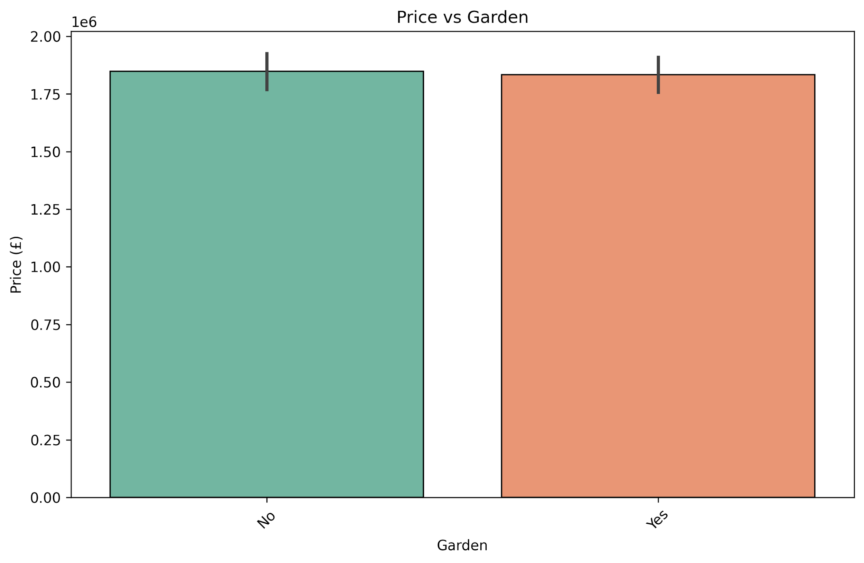
THIS BAR CHART COMPARES THE AVERAGE PROPERTY PRICES BETWEEN HOMES WITH GARDENS AND THOSE WITHOUT.
PROPERTIES WITH GARDENS OFTEN COMMAND HIGHER PRICES BECAUSE OUTDOOR SPACE INCREASES COMFORT, USABILITY, AND PRESTIGE.
HOMES WITHOUT GARDENS USUALLY HAVE LOWER PRICES, MAKING THEM MORE BUDGET-FRIENDLY.
THE CHART HELPS TO HIGHLIGHT HOW LIFESTYLE FEATURES LIKE A GARDEN CAN DIRECTLY AFFECT PROPERTY VALUATION.

Slide 53
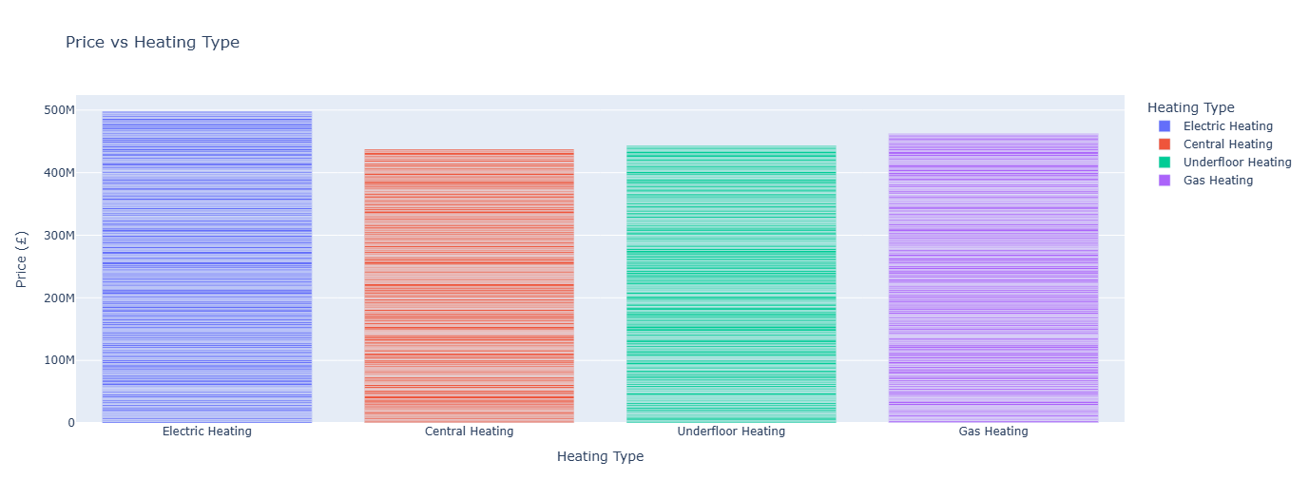
THIS BAR CHART SHOWS HOW PROPERTY PRICES VARY DEPENDING ON THE TYPE OF HEATING SYSTEM.
SOME HEATING TYPES (E.G., CENTRAL HEATING OR MODERN SYSTEMS) MAY BE LINKED WITH HIGHER PROPERTY VALUES, AS THEY IMPROVE COMFORT AND EFFICIENCY.
TRADITIONAL OR LESS EFFICIENT HEATING SYSTEMS MIGHT CORRESPOND TO LOWER PRICES.
THIS VISUALIZATION HIGHLIGHTS HOW INFRASTRUCTURE FEATURES, SUCH AS HEATING, CAN INFLUENCE BUYER PREFERENCES AND OVERALL PROPERTY VALUATION.

Slide 54
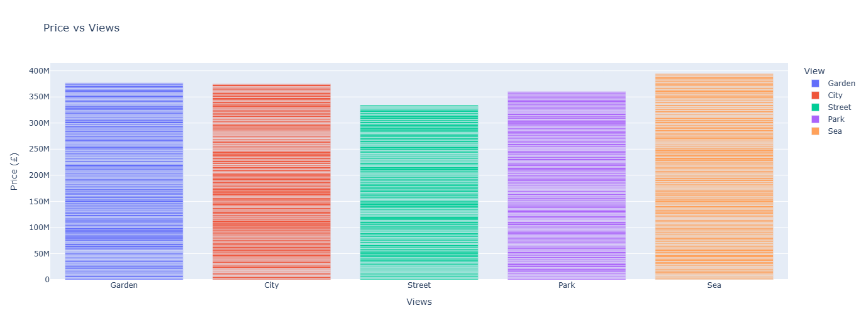
THIS BAR CHART COMPARES AVERAGE PROPERTY PRICES ACROSS DIFFERENT TYPES OF VIEWS.
PROPERTIES WITH PREMIUM VIEWS (SUCH AS SEA, RIVER, OR PARK) GENERALLY SHOW HIGHER PRICES, AS LOCATION AESTHETICS ADD STRONG VALUE.
HOMES WITH STANDARD OR LESS ATTRACTIVE VIEWS TEND TO BE CHEAPER, MAKING THEM MORE BUDGET-FRIENDLY.
THE CHART HIGHLIGHTS HOW MUCH THE VISUAL SURROUNDINGS CONTRIBUTE TO PROPERTY VALUATION AND BUYER PREFERENCES.

Slide 55
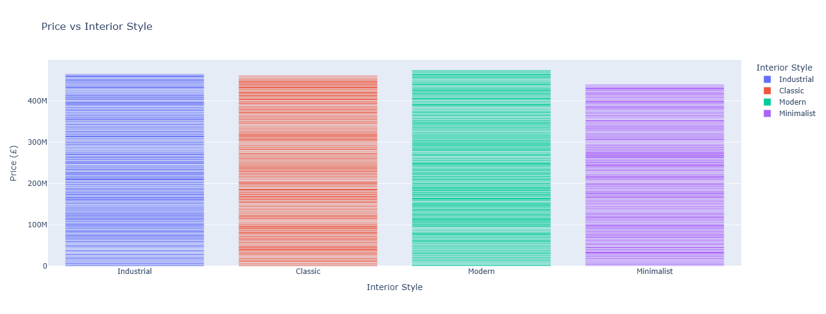
THIS BAR CHART SHOWS HOW DIFFERENT INTERIOR DESIGN STYLES INFLUENCE PROPERTY PRICES.
PROPERTIES WITH MODERN OR LUXURY INTERIOR STYLES USUALLY HAVE HIGHER PRICES BECAUSE THEY APPEAL TO BUYERS SEEKING COMFORT AND AESTHETICS.
MORE BASIC OR TRADITIONAL STYLES MAY CORRESPOND TO LOWER PRICES, ATTRACTING BUYERS ON A TIGHTER BUDGET.
THE CHART HIGHLIGHTS HOW INTERIOR DESIGN CHOICES CAN SIGNIFICANTLY AFFECT PROPERTY VALUE BEYOND JUST SIZE OR LOCATION.

Slide 56
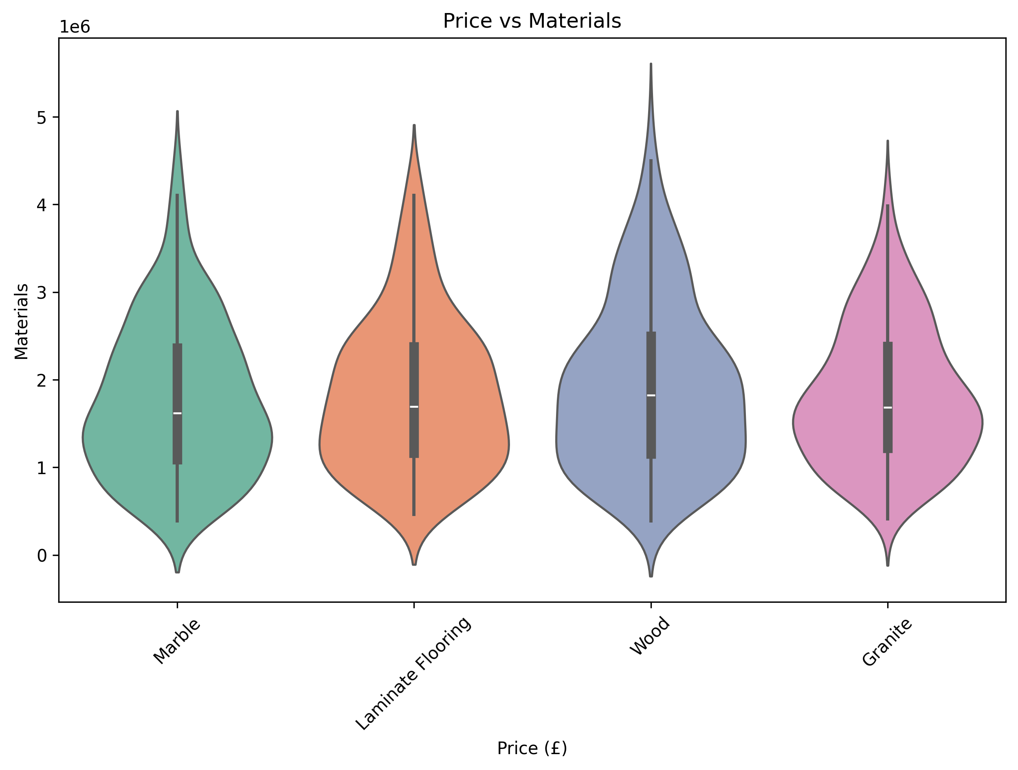
THIS VIOLIN PLOT SHOWS THE DISTRIBUTION OF PROPERTY PRICES ACROSS DIFFERENT BUILDING MATERIALS.
THE SHAPE OF EACH VIOLIN INDICATES HOW PRICES ARE SPREAD FOR THAT MATERIAL (WIDER PARTS = MORE COMMON PRICE RANGES).
MATERIALS ASSOCIATED WITH LUXURY OR DURABILITY (E.G., HIGH-QUALITY STONE, REINFORCED CONCRETE) MAY SHOW HIGHER PRICE RANGES.
MORE BASIC OR INEXPENSIVE MATERIALS LIKELY CORRESPOND TO LOWER PRICES.
THE PLOT ALSO HIGHLIGHTS VARIABILITY: SOME MATERIALS HAVE TIGHT PRICE RANGES, WHILE OTHERS SHOW A BROAD SPREAD (CHEAP AND EXPENSIVE PROPERTIES BOTH USING THE SAME MATERIAL).

Slide 57
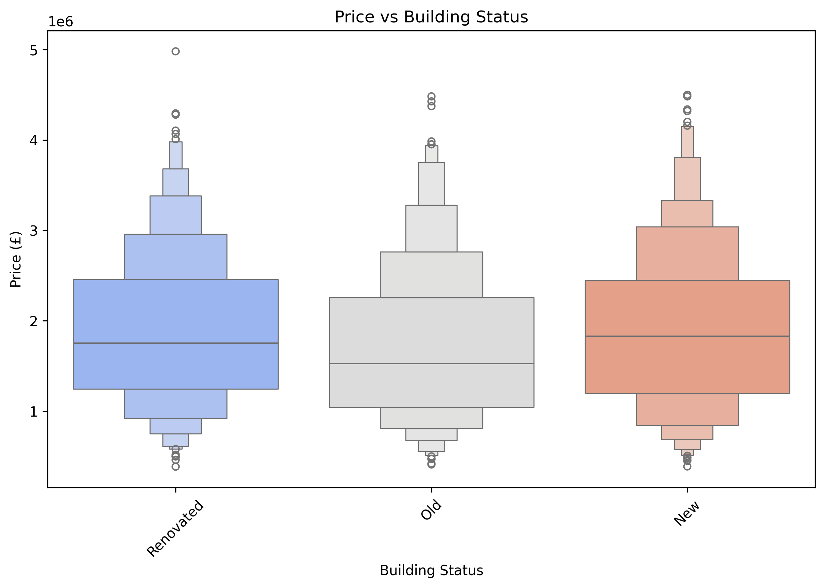
THIS PLOT COMPARES PROPERTY PRICES ACROSS DIFFERENT BUILDING STATUSES (E.G., NEW, UNDER CONSTRUCTION, OLD).
NEWLY BUILT PROPERTIES OFTEN SHOW HIGHER PRICES DUE TO MODERN DESIGN AND MINIMAL MAINTENANCE NEEDS.
UNDER-CONSTRUCTION PROPERTIES MAY HAVE VARYING PRICES DEPENDING ON LOCATION AND EXPECTED QUALITY.
OLDER PROPERTIES USUALLY HAVE LOWER PRICES, UNLESS THEY HAVE HISTORICAL OR PREMIUM VALUE.
THE PLOT ALSO HIGHLIGHTS OUTLIERS, SUCH AS EXCEPTIONALLY EXPENSIVE OLD BUILDINGS OR AFFORDABLE NEW PROJECTS.

Slide 58
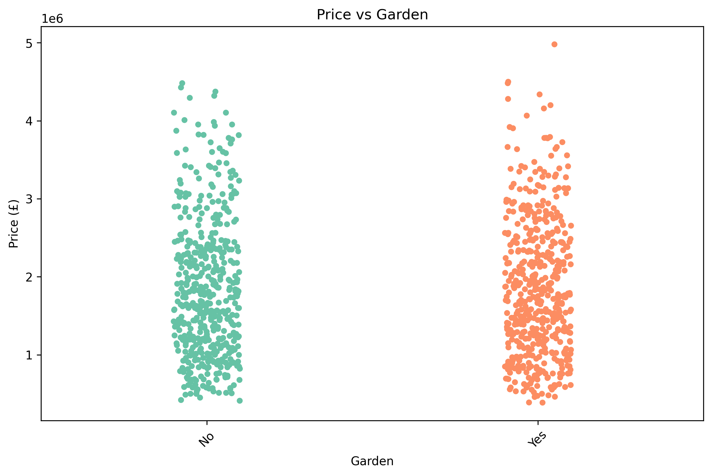
THIS STRIP PLOT DISPLAYS INDIVIDUAL PROPERTY PRICES FOR HOMES WITH AND WITHOUT GARDENS.
EACH POINT REPRESENTS A PROPERTY, SO WE CAN SEE THE SPREAD OF PRICES, NOT JUST THE AVERAGE.
PROPERTIES WITH GARDENS OFTEN CLUSTER AT HIGHER PRICE POINTS, SHOWING ADDED VALUE FOR OUTDOOR SPACE.
HOMES WITHOUT GARDENS GENERALLY APPEAR AT LOWER PRICE LEVELS.
OUTLIERS MAY INDICATE UNUSUALLY EXPENSIVE OR CHEAP PROPERTIES RELATIVE TO GARDEN PRESENCE.

Slide 59

THIS HISTOGRAM SHOWS HOW BUILDING AGES ARE DISTRIBUTED ACROSS THE DATASET.
THE KDE CURVE HELPS VISUALIZE THE DENSITY OF PROPERTIES AT DIFFERENT AGES.
PEAKS INDICATE COMMON BUILDING AGE RANGES (E.G., MANY PROPERTIES BUILT RECENTLY OR DURING CERTAIN DECADES).
FEWER PROPERTIES EXIST AT EXTREME AGES (VERY OLD OR VERY NEW).
THIS PLOT HELPS UNDERSTAND THE GENERAL AGE PROFILE OF THE REAL ESTATE MARKET AND IDENTIFY CLUSTERS OR GAPS IN CONSTRUCTION PERIODS.

Slide 60

THIS HEATMAP SHOWS THE STRENGTH AND DIRECTION OF RELATIONSHIPS BETWEEN NUMERIC FEATURES:
POSITIVE CORRELATIONS (CLOSE TO +1) INDICATE THAT AS ONE FEATURE INCREASES, THE OTHER TENDS TO INCREASE.
NEGATIVE CORRELATIONS (CLOSE TO -1) INDICATE THAT AS ONE FEATURE INCREASES, THE OTHER TENDS TO DECREASE.
FOR EXAMPLE, PRICE VS SQUARE METERS USUALLY SHOWS A STRONG POSITIVE CORRELATION.
FEATURES WITH WEAK CORRELATIONS (CLOSE TO 0) HAVE LITTLE LINEAR RELATIONSHIP.
THIS VISUALIZATION HELPS IDENTIFY KEY FACTORS INFLUENCING PRICE AND GUIDES FURTHER ANALYSIS.

Slide 61

THIS BAR CHART SHOWS THE TOP 10 MOST EXPENSIVE PROPERTIES IN THE DATASET ALONG WITH THEIR NEIGHBORHOODS AND ADDRESSES:
HIGHLIGHTS WHICH NEIGHBORHOODS CONTAIN THE HIGHEST-PRICED PROPERTIES, HELPING UNDERSTAND MARKET HOTSPOTS.
SHOWS PRICE GAPS BETWEEN LUXURY PROPERTIES, ILLUSTRATING DIFFERENCES IN PROPERTY VALUE.
USEFUL FOR INVESTORS OR BUYERS TO IDENTIFY WHERE PREMIUM PROPERTIES ARE CONCENTRATED.
HELPS IN MARKET ANALYSIS AND STRATEGIC PLANNING BY PINPOINTING HIGH-VALUE AREAS.
PROVIDES A QUICK OVERVIEW OF THE LUXURY SEGMENT IN THE REAL ESTATE MARKET.

Slide 62
THROUGH THIS VISUAL ANALYSIS, WE HAVE IDENTIFIED KEY FACTORS THAT AFFECT PROPERTY PRICES AND MARKET TRENDS:
PROPERTY SIZE, NUMBER OF BEDROOMS, BATHROOMS, AND AMENITIES LIKE GARDEN OR BALCONY ARE STRONG PRICE DETERMINANTS.
NEIGHBORHOOD AND VIEW QUALITY SIGNIFICANTLY INFLUENCE THE VALUE OF PROPERTIES.
BUILDING FEATURES SUCH AS AGE, STATUS, INTERIOR STYLE, AND MATERIALS ALSO IMPACT PRICING.
THE TOP 10 MOST EXPENSIVE PROPERTIES HIGHLIGHT MARKET HOTSPOTS AND THE LUXURY SEGMENT.
CORRELATION ANALYSIS HELPS UNDERSTAND WHICH NUMERICAL FEATURES ARE MOST CLOSELY RELATED TO PRICE.
OVERALL, THIS REPORT PROVIDES A CLEAR AND COMPREHENSIVE UNDERSTANDING OF THE REAL ESTATE MARKET, SUPPORTING DATA-DRIVEN DECISIONS AND STRATEGIC PLANNING.
Conclusion

